Slide 1
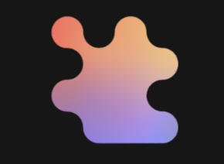
MCP and Agents: Open-Source Foundations for Agent Trust, Safety, and Scale
TechXchange | October 6-7, 2025
Fred Arauju: IBM Research
Dean Wampler, Jeffrey Borek, Dave Nielsen: IBM and The AI Alliance
© 2023-2025, AI Alliance. AI-enhanced photographs, © 2021-2025, Dean Wampler.
Notes:
© 2023-2025 The AI Alliance. AI-enhanced photographs © 2021-2025, Dean Wampler.

Slide 2

Outline

Slide 3

Outline
ContextForge
What Is the AI Alliance… and Why?
Building AI-empowered Applications: Agents, MCP, … and More
A Quick Look at Other AI Trends and AIA Projects
Final Thoughts

Slide 4
Outline
ContextForge
What Is the AI Alliance… and Why?
Building AI-empowered Applications: Agents, MCP, … and More
A Quick Look at Other AI Trends and AIA Projects
Final Thoughts

Slide 5
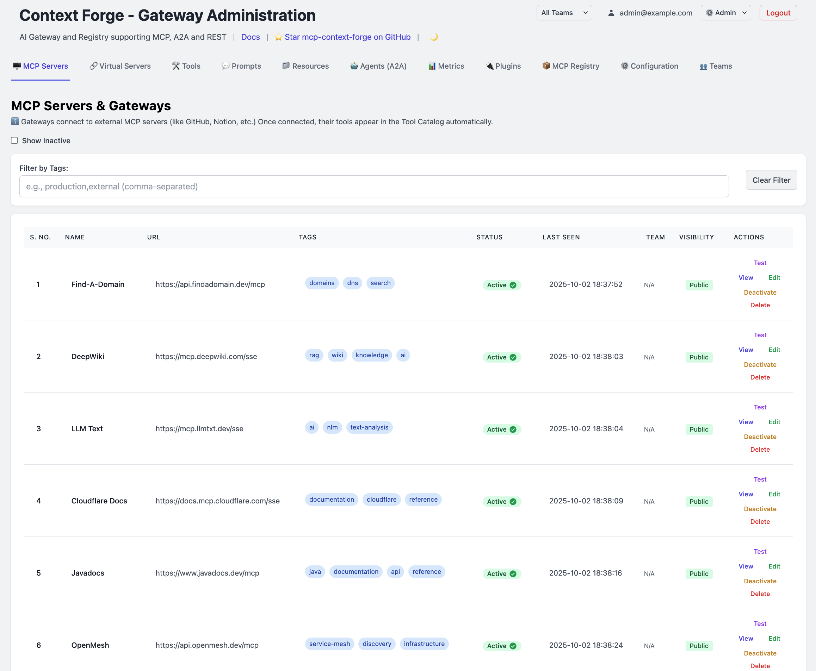
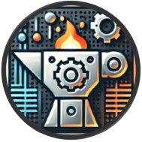
ContextForge
MCP Gateway
Secure Open-Source Gateway, Proxy and Registry for AI Agents and Tools
Unifying discovery, authentication, authorization, role-based access control, rate-limiting, observability, virtual servers, and protocol translation – with a security focus and configurable plugins
github.com/IBM/mcp-context-forge

Slide 6
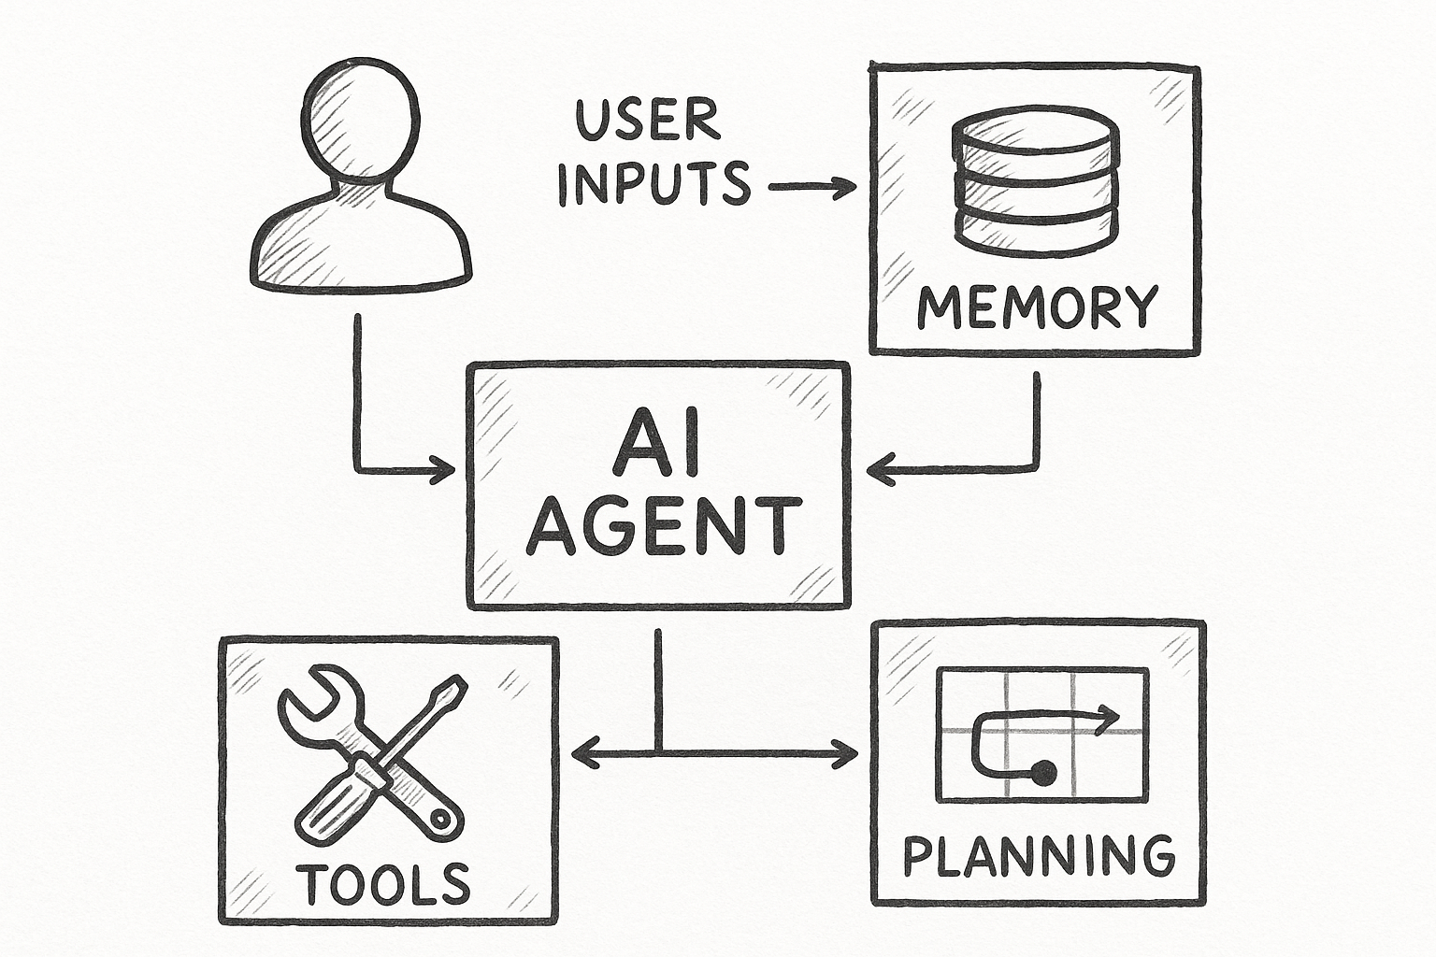
AI Agents use tools to accomplish complex tasks
AI Agent
A modular, goal-driven component that uses tools, memory, and reasoning to autonomously complete tasks via language models
These agents can plan, interact with APIs or other agents, and make decisions based on prompts, documents, or user input. They're often orchestrated in a multi-agent system to collaboratively solve complex problems
They typically use an agentic framework or orchestrator (e.g., langgraph, langchain, autogen, crew.ai) for tool execution
What can they do with tools?
Retrieve external information (e.g., web search, databases, RAG) as necessary, call other Agents or request user input
Generate artifacts (images, diagrams, word documents, excel files), interact with external APIs and systems using various Tools, run unit tests, etc.
https://github.com/IBM/mcp-context-forge
Notes:
Here’s how AI Agents actually work in practice:
An AI Agent is more than just a chatbot — it’s a goal-oriented system that can plan and execute tasks. It uses an LLM to decide what to do next — we call that 'planning'.
But it doesn't do everything itself. It relies on an agentic framework or orchestrator — like LangChain, Autogen, or Watson Orchestrate — to manage the steps, and call external tools to actually do the work.
So what can agents do with these tools? They can search the internet, look things up in Wikipedia or Google, access internal databases, or even run code or generate documents.
On the right, we see a typical flow: the agent takes a user request, plans its response, calls tools like a browser or code interpreter, and keeps going through the Thought → Action → Observation loop until the task is complete.
For example, imagine a coding assistant that looks up a Python function in a browser, tests it in a code interpreter, and documents the results — all in one loop.
This is what makes agents powerful — but only if they have the right tools and the right way to use them, which is where standards like MCP and the MCP Gateway come in!

Slide 7
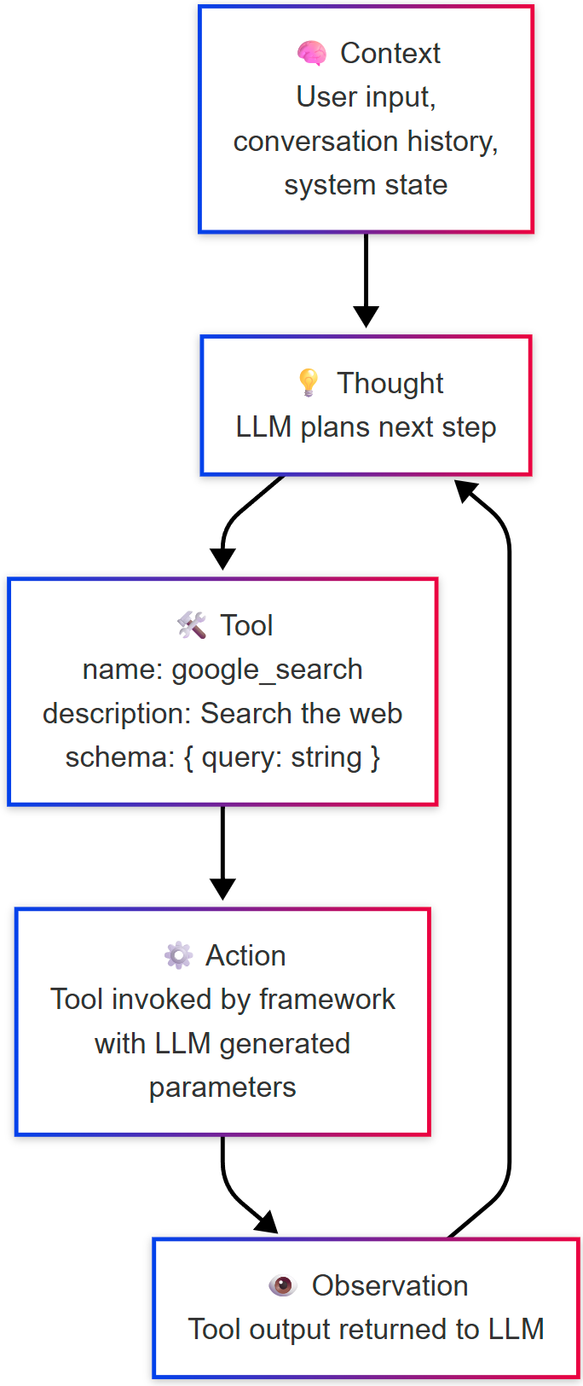
Agents and tools turn “thoughts” into actions
Large Language Models call Tools through "Agentic Frameworks”; The LLM selects the right tool and parameters based on its description, then processes the output. Example
name: google_search
description: Use this tool to search the internet, providing an input prompt.
input schema: {"query": "Latest News"}
MCP standardizes how AI Agents interact with Tools
MCP de-couples AI Tools from the Agentic Platform
Without MCP, each framework or AI tool would duplicate work, and LLMs couldn't be 'fine tuned' for standardized tool calling.
https://github.com/IBM/mcp-context-forge
Notes:
Agents don’t just generate text — they take action. Tools are how they do that. A tool is anything the agent can call to get something done — search the web, update a system, send a message.
Each tool is defined by three things:
A name, like google_search
A description, which tells the LLM when it should use it
And an input schema, which shows what parameters the tool expects
The agent — using the LLM — looks at the context, plans the next step, and decides which tool to use. It fills in the input based on the user’s request, and the framework executes the call.
On the right is the full loop:
The agent observes context
Thinks and plans a step
Chooses a tool and fills in the input
Executes the tool
Then observes the result and decides what to do next
This is how we go from language to real-world action — and tools make that possible.
However, without a standard like MCP, every single agentic framework - Langchain, Langgraph, Crew.AI, Autogen, AutoGPT, Pydanic, OpenAI SDK, Langflow, Watsonx Orchestrate, etc. or any of the Coding tools like Claude Code, Visual Studio Code – Copilot, Cline, Continue, etc. would need their own specific definition / code to access a tool!
MCP simplifies that, it's the 'Container' of AI tools – while MCP Gateway is the "Kubernetes" for MCP!

Slide 8
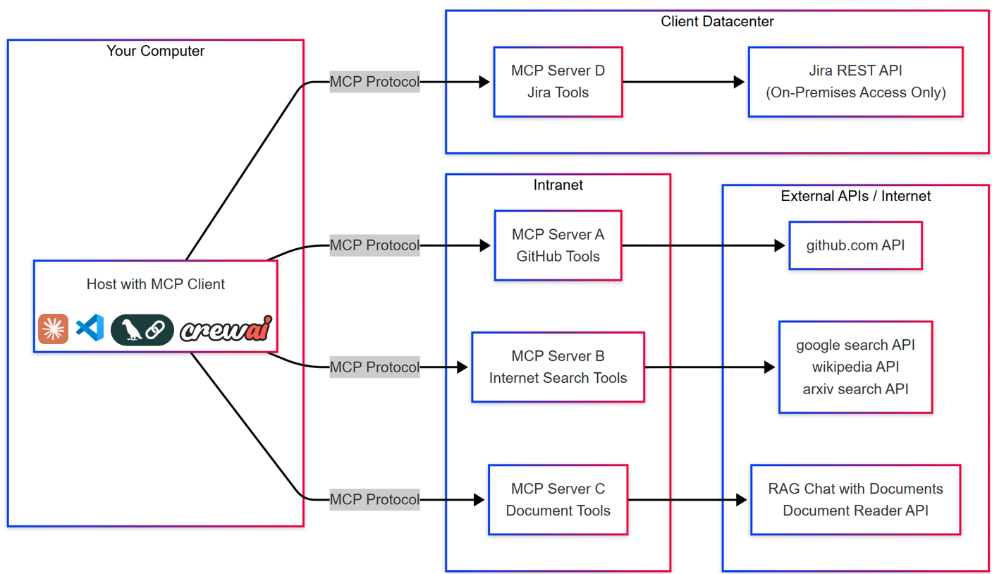
Model Context Protocol (MCP) – "the USB‑C for AI tools"
MCP Overview
An open protocol introduced by Anthropic in November 2024 to standardize tool calling
Enables a consistent interface to define how Agents and applications discover, invoke, and interact with tools and other context (prompts, resources)
Widely adopted: 15,000+ community servers developed since launch; wide adoption by major vendors
Still Evolving: the standard is rapidly evolving to resolve gaps in security, granular access controls, transparent tool usage, and user interaction, but many tools only implement a partial or older spec
MCP Hosts: applications or AI tools that want to access data via MCP (VSCode+ Copilot/Cline/Continue, Langchain, Crew.AI, Claude Desktop)
MCP Clients: Protocol clients that maintain 1:1 connections with servers
MCP Servers: Lightweight programs that each expose specific capabilities through Model Context Protocol
ContextForge addresses these gaps
https://github.com/IBM/mcp-context-forge
Notes:
MCP — or Model Context Protocol — was introduced by Anthropic in November 2024 to address exactly the challenges we just talked about.
It’s an open protocol that standardizes how AI agents discover, connect to, and call tools — across frameworks, vendors, and platforms.
Think of it like USB-C for AI tools. It defines a consistent format for how tools are listed, how input is passed, and how results are returned.
It’s already widely adopted: over 15,000 community servers have been built, and companies like IBM, Microsoft, Google, OpenAI, AWS, and Salesforce are all using or supporting MCP.
MCP separates responsibilities into three roles:
MCP Hosts are environments like IDEs or agent platforms — they run the client and coordinate the experience.
MCP Clients maintain connections to tool servers and issue requests.
And MCP Servers expose tools, wrapping APIs like Google Search, Jira, GitHub, or internal systems.
The standard is still evolving — adding better security, user context handling, and more powerful interaction patterns — but the ecosystem is already strong, and growing fast.
Many tools only implement a partial or older spec, and there are a many gaps in HA, security, authentication, authorization, observability, etc. restricting Enterprise usage.
MCP Gateway aims to address all these gaps and provide the "Kubernetes of MCP" solution.

Slide 9
ContextForge addresses challenges with the MCP Ecosystem
MCP challenges
MCP gained rapid adoption — but the ecosystem evolved unevenly. Many tools only partially implement the spec, and integration challenges remain:
Existing tools: REST endpoints must be rewritten to become MCP-compliant.
Protocol and security inconsistency: some use JWT authentication, others OAuth2, many use nothing at all –while most servers are still developed to stdio / SSE transport (instead of the newer streamable HTTP).
Integration complexity: tools are scattered across servers, each with its own config, retry logic, and monitoring gaps
MCP Gateway emerges as a mandatory pattern when deploying MCP in the enterprise
Acts as a secure, unified proxy between AI agents and tool servers, easily deployable in remote environments.
Convert between different transports, add authorization, security, observability, retry logic, and tool lifecycle controls – allowing you to quickly convert non-compliant MCP servers to the latest standard, and add security, observability, etc.
Wrap any REST API and exposes it as a typed, discoverable MCP-compatible tool
Reusable building block, easily embedded into other products and tools
https://github.com/IBM/mcp-context-forge
Notes:
MCP Gateway is to MCP what Kubernetes is to Docker: a way to manage and orchestrate MCP Tools, at scale, in the enterprise.
Tools are meant to be small, focused pieces of functionality — like search, summarization, or sending an email. But building them today is harder than it should be.
1. First, the ecosystem is fragmented. Most tools are built for a specific framework — like LangChain or Autogen — which makes it hard to reuse them across systems.
2. There’s also a lack of standardization. Tools may define their inputs and outputs differently, use different schemas, or rely on custom prompt formats. That leads to confusion and duplicated effort.
3. Many tools run locally, right inside the agent’s process, instead of as independent, scalable services. That limits how we can share and scale them.
4. And finally, there’s no shared registry. No easy way to find tools, publish them, or reuse them across teams — everyone builds in silos.
The result? High friction, duplicated code, and tools that don’t interoperate across frameworks. This is the gap that MCP is designed to solve.

Slide 10
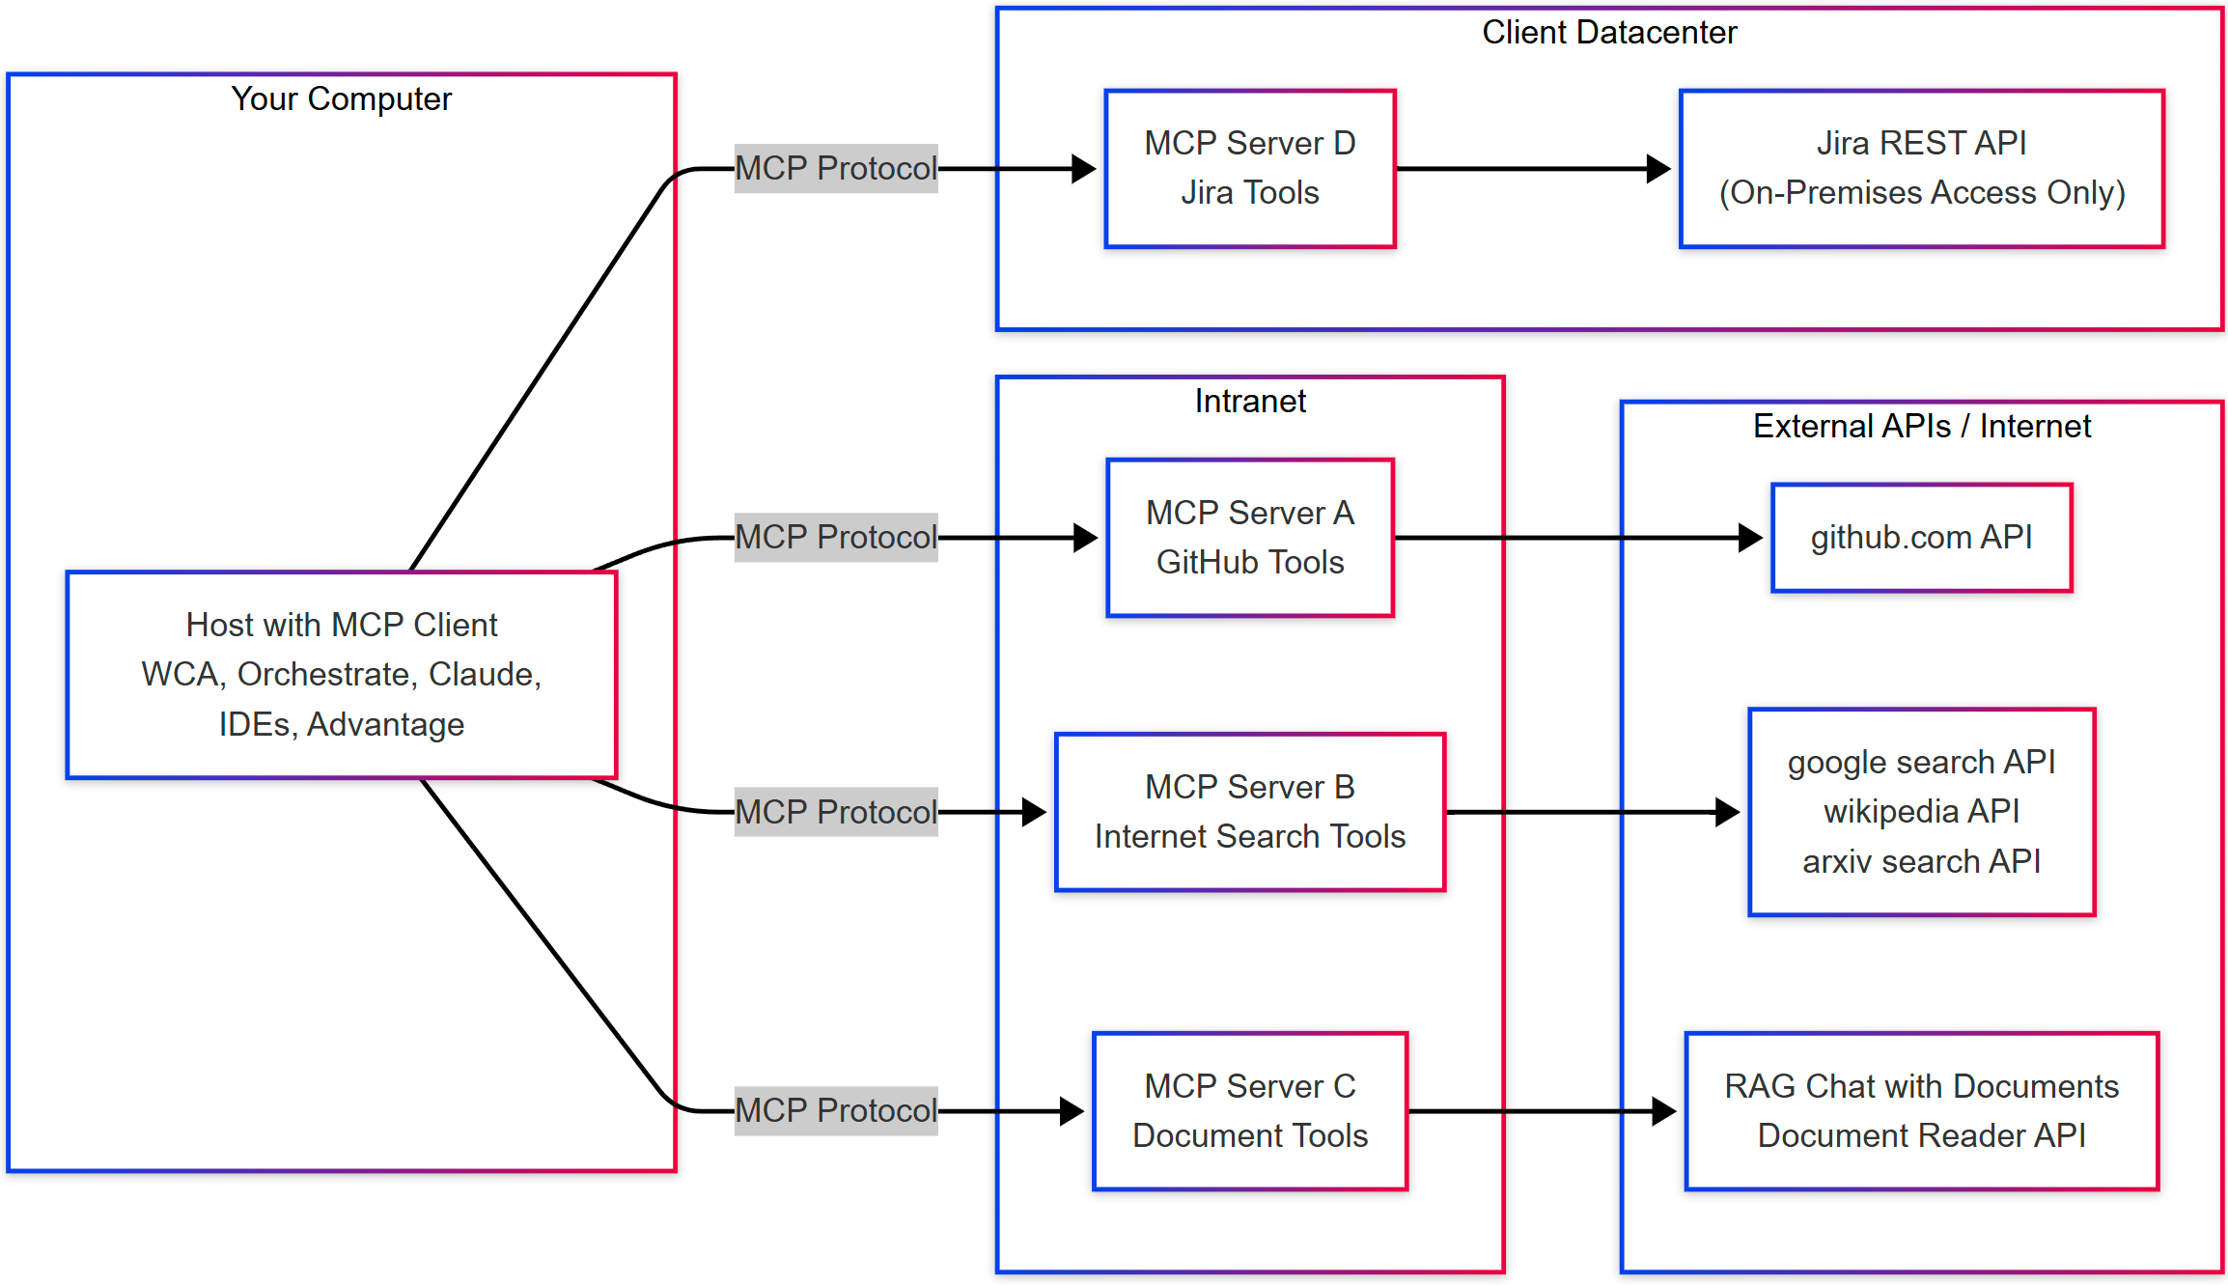



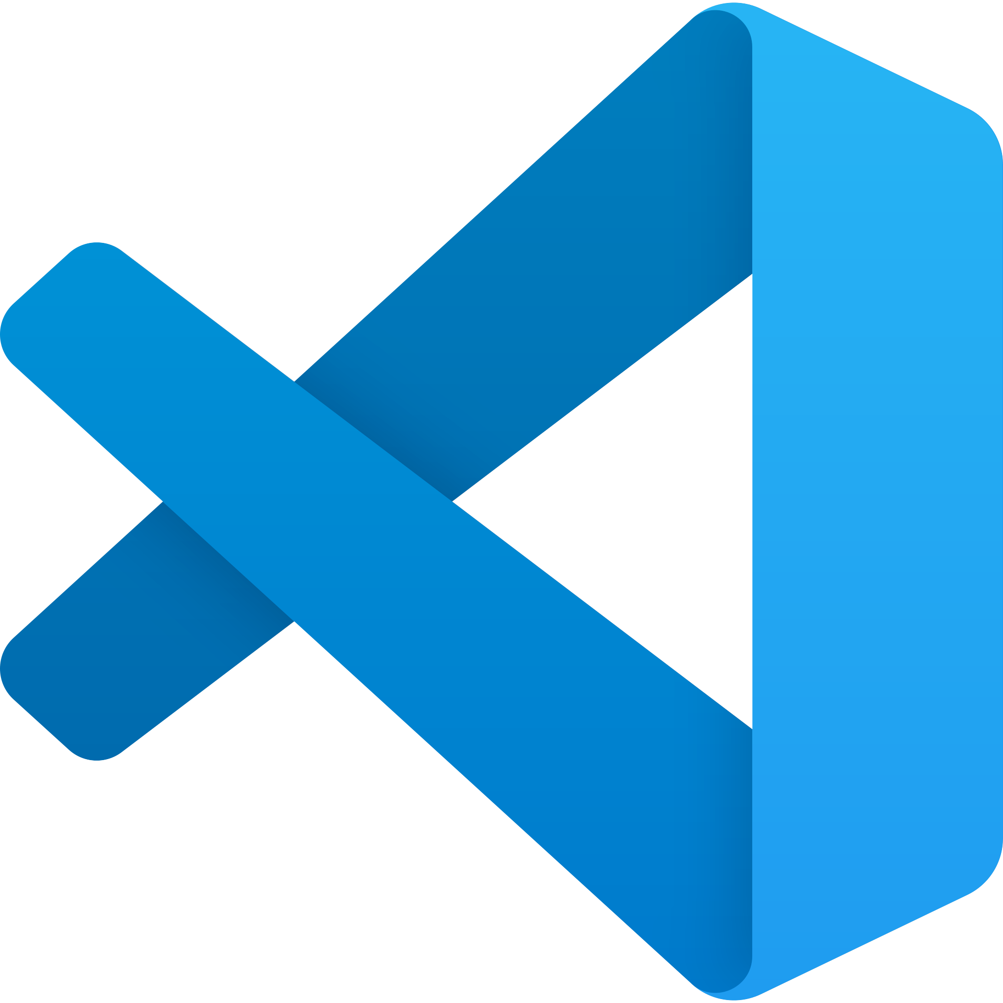
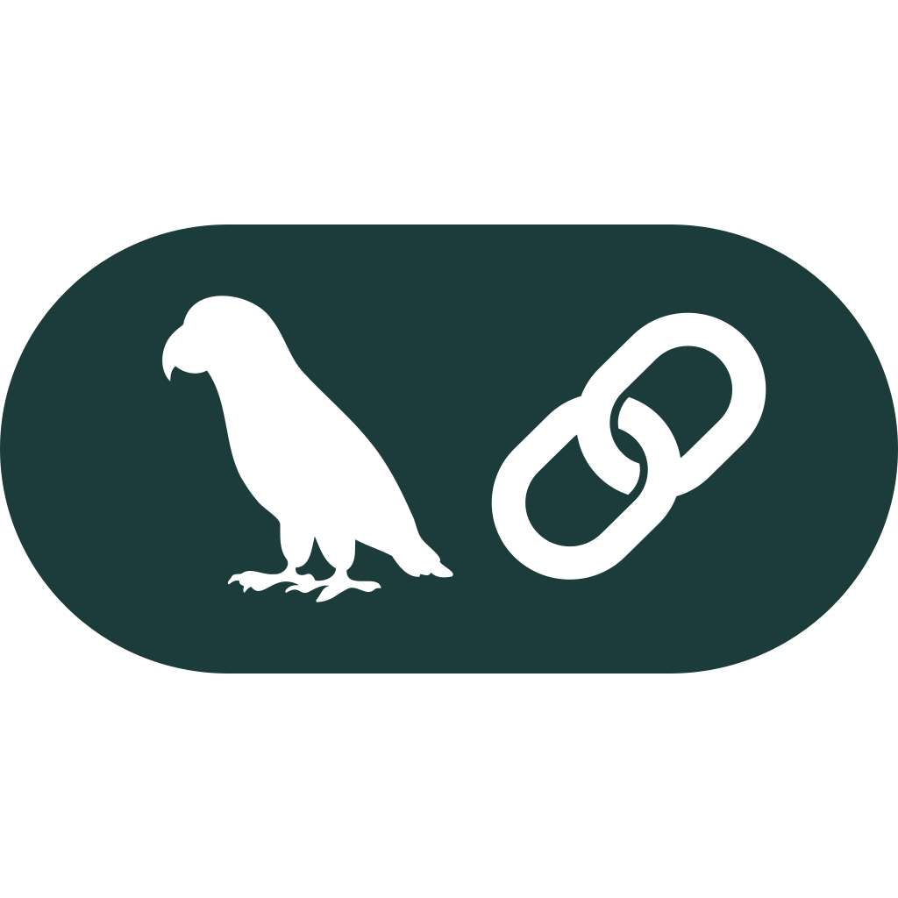

ContextForge: open source secure, modular proxy for MCP
ContextForge MCP Gateway
Registry
Virtual Servers
Pre/Post Plugins:
Authorization
Authentication
XSS Filtering PII Filtering
OPA
Observability
Protocol Conversion any to any
(stdio, SSE, Streamable HTTP, JSON-RPC, REST)
Observability
Rate Limiting
HA / Routing
Healthchecks
API / UI / CLI
Tags
Approvals
STDIO -> SSE + Auth
STDIO -> Gateway + Auth
Your A2A Agents
run local stdio MCP Servers and federate them to the gateway
Your REST APIs
https://github.com/IBM/mcp-context-forge
Notes:
Think of the Gateway as the traffic-cop and smart-proxy between every MCP client (VS Code, Crewai, CLI, watsonx Orchestrate etc.) and every MCP server.
Registry & discovery: it keeps a catalog of available servers/tools so clients can find them with one call.
Security guard-rails: handles authentication and authorization centrally—no more embedding secrets in each server.
Protocol translator: converts between stdio, SSE, streamable HTTP, JSON-RPC, and REST so mismatched clients/servers still talk smoothly.
Enterprise plumbing: adds observability, rate-limiting, health-checks, and high-availability routing—things individual servers usually lack.
Virtual servers: lets us host multiple logical servers behind one endpoint, simplifying network rules.
Bottom line: a single, secure, managed doorway that operationalizes MCP for both on-prem and external APIs, giving devs convenience and ops teams control.

Slide 11
Security-first design
Core Security Mission
Protect against untrusted MCP servers
Sanitize all inputs/outputs
Policy-based access control
Pluggable security middleware
Isolation Capabilities
Separate tool namespaces
Independent auth configs
Per-server rate limits
Custom security policies
Enterprise Security
Policy as Code with OPA
SSO Integration (OAuth/SAML), JWT
RBAC, Multi-tenancy, Database Encryption
Observability (OpenTelemetry)
https://github.com/IBM/mcp-context-forge

Slide 12
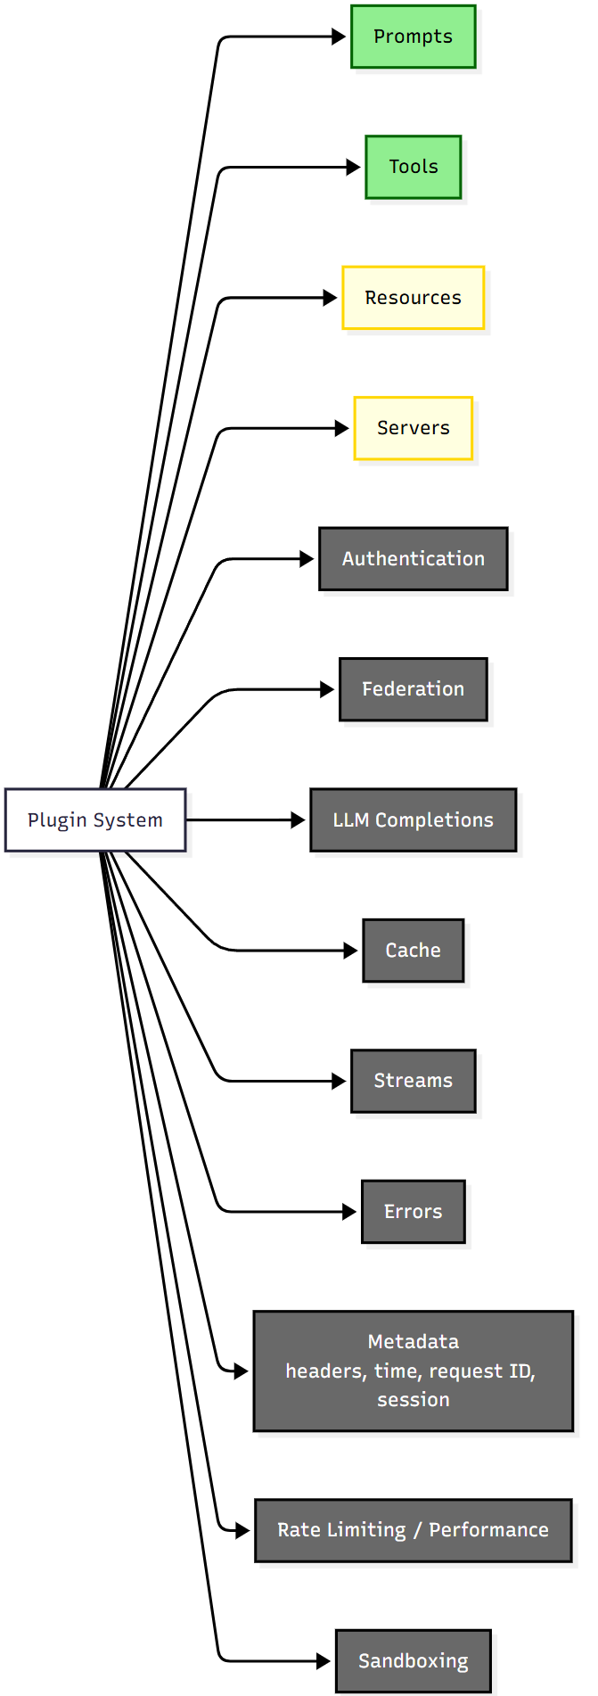
ContextForge with Pluggable Security
Guardrails
Security extensions implemented as LSM-style hooks to ContextForge
Access Control & Sandboxing
ContextForge
Information Flow
MCP Server
Agent
prehook
tool
API Call
resource
prompt
posthook
CRUD
Guardrails
Access Control & Sandboxing
Information Flow
IBM | https://github.com/IBM/mcp-context-forge

Slide 13
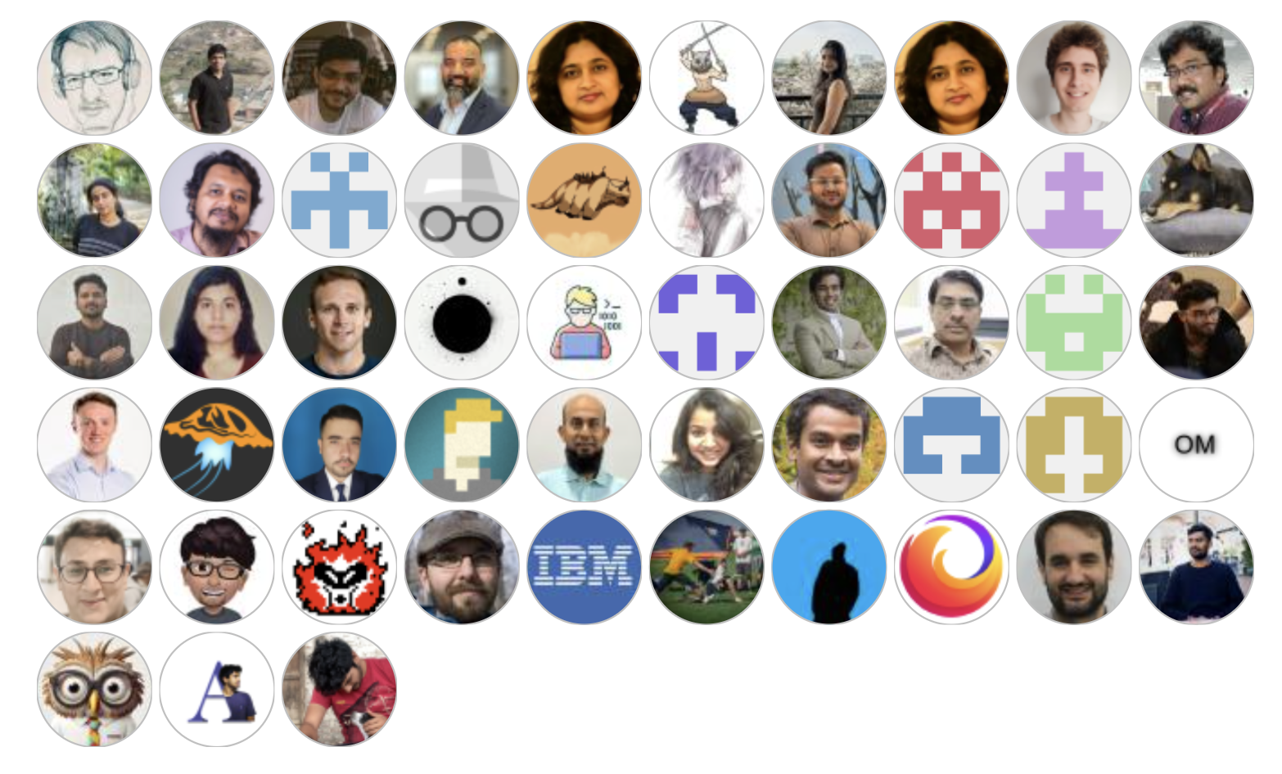
Community engagement and growth
2.6k+ stars
319 forks
57 contributors
The most popular MCP Gateway!
– with highest number of features and a security focus

Slide 14
Outline
ContextForge
What Is the AI Alliance… and Why?
Building AI-empowered Applications: Agents, MCP, … and More
A Quick Look at Other AI Trends and AIA Projects
Final Thoughts

Slide 15
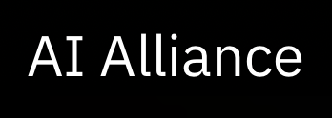
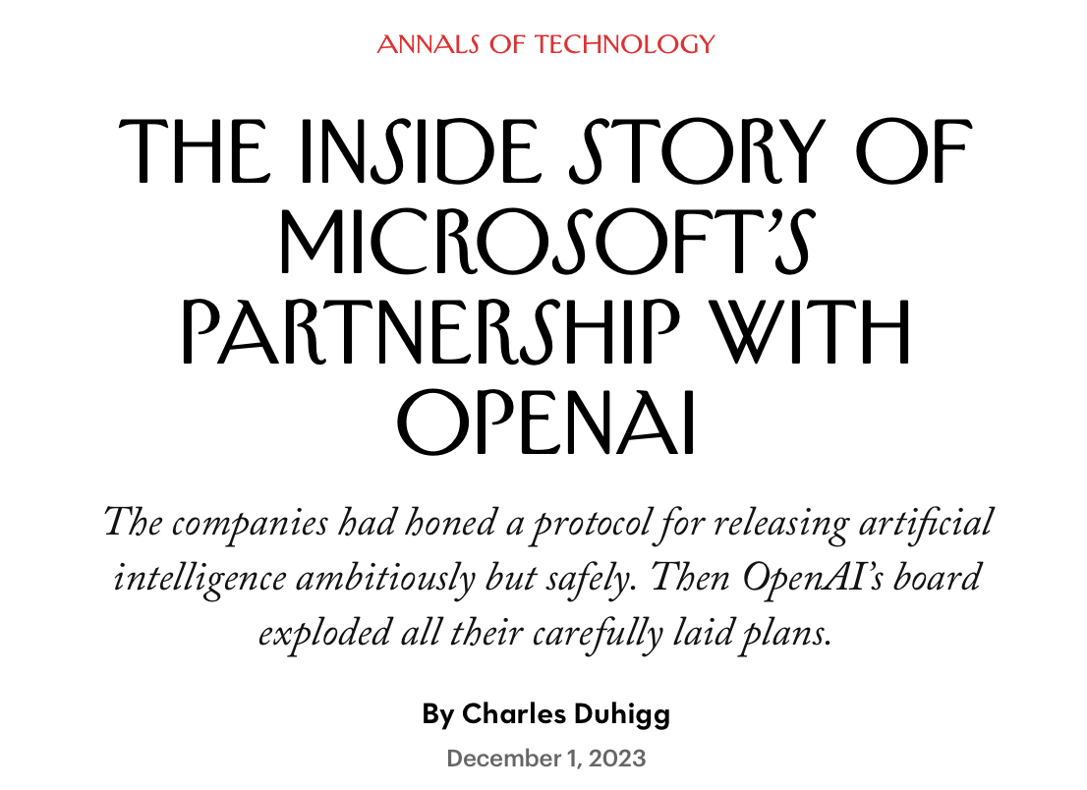
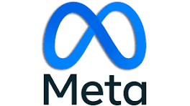
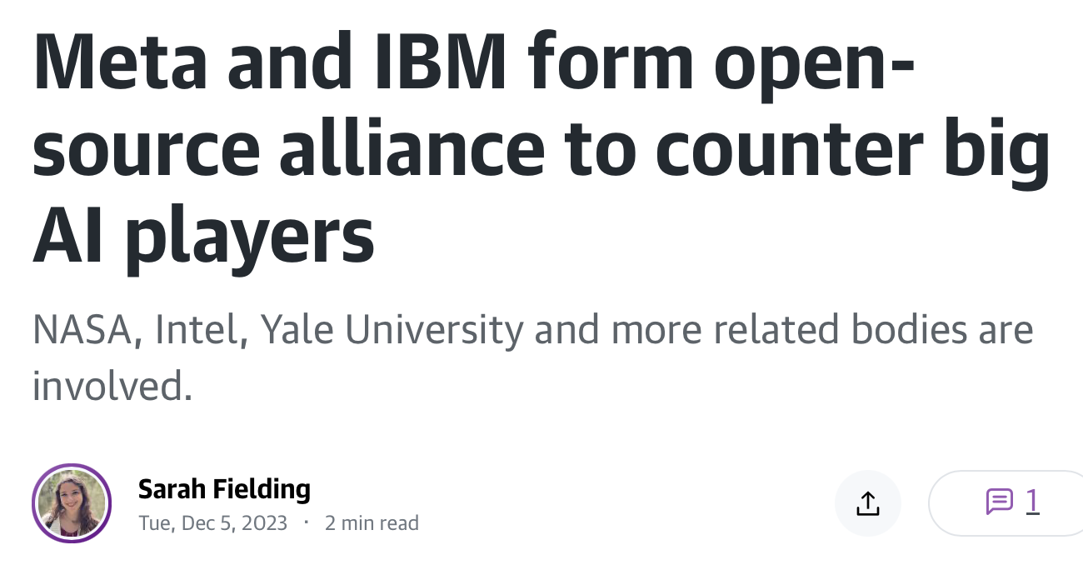






Trends in Artificial Intelligence - Closed or Open?
“The future of AI is open — no matter what some say.”
Dario Gill, SVP and Director of Research, IBM
Notes:
KEY POINTS:
Almost everyone has heard about the major disruption to the leadership of OpenAI that happened at the end of 2023, where Sam Altman was removed as the CEO, then Satya Nadella announced that Sam would join Microsoft, and then he reinstated as CEO at OpenAI. But many do not know that a contributing factor to the chaos is that OpenAI was launched back in 2015 as a NONPROFIT ORGANIZATION which pledged to share all its findings publicly due to safety and existential risk concerns. They formed a FORPROFIT subsidiary so they could become proprietary and signed a contract with Microsoft.
In mid-2023, OpenAI, Anthropic, Google and Microsoft formed a lobbying group called the Frontier Model Forum with membership criteria that greatly restricted who could join their ‘club’ and was making the argument that they would collaborate amongst themselves on safe and responsible AI development. A move that caused broad concern across the industry.
This is why over 50 organization including IBM, Meta, Harvard, The Linux Foundation, NASA, Intel and others came together in December to announce the formation of the AI Alliance - focused on fostering an open community and enabling developers and researchers to accelerate responsible innovation in AI while ensuring scientific rigor, trust, safety, security, diversity and economic competitiveness.

Slide 16
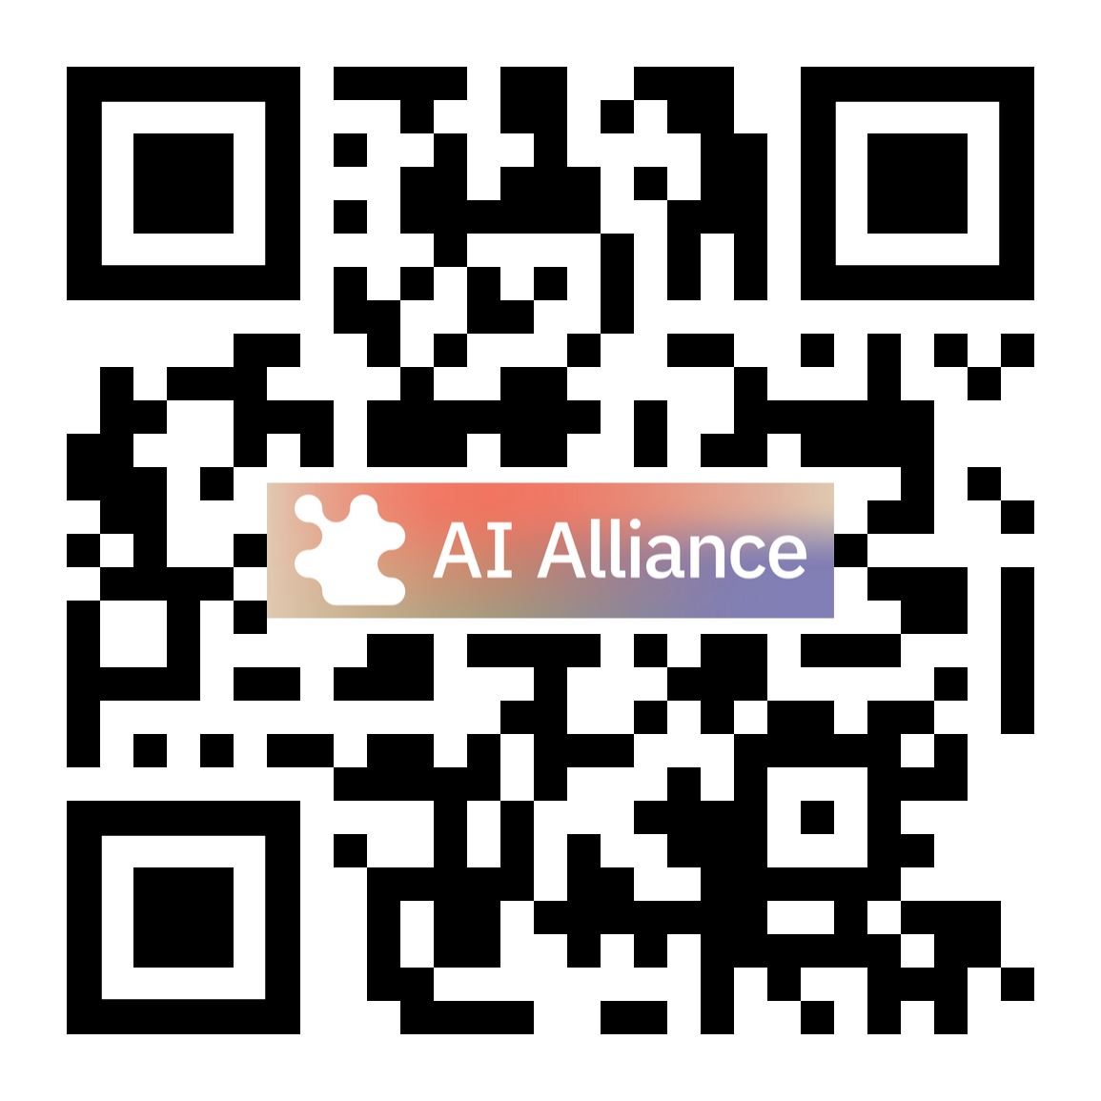




The AI Alliance brings together organizations, people, and resources to accelerate open innovation, technology development and adoption.
aialliance.org
Launched December 5, 2023
linkedin.com/company/the-aialliance/
bsky.app/profile/aialliance.bsky.social

Slide 17
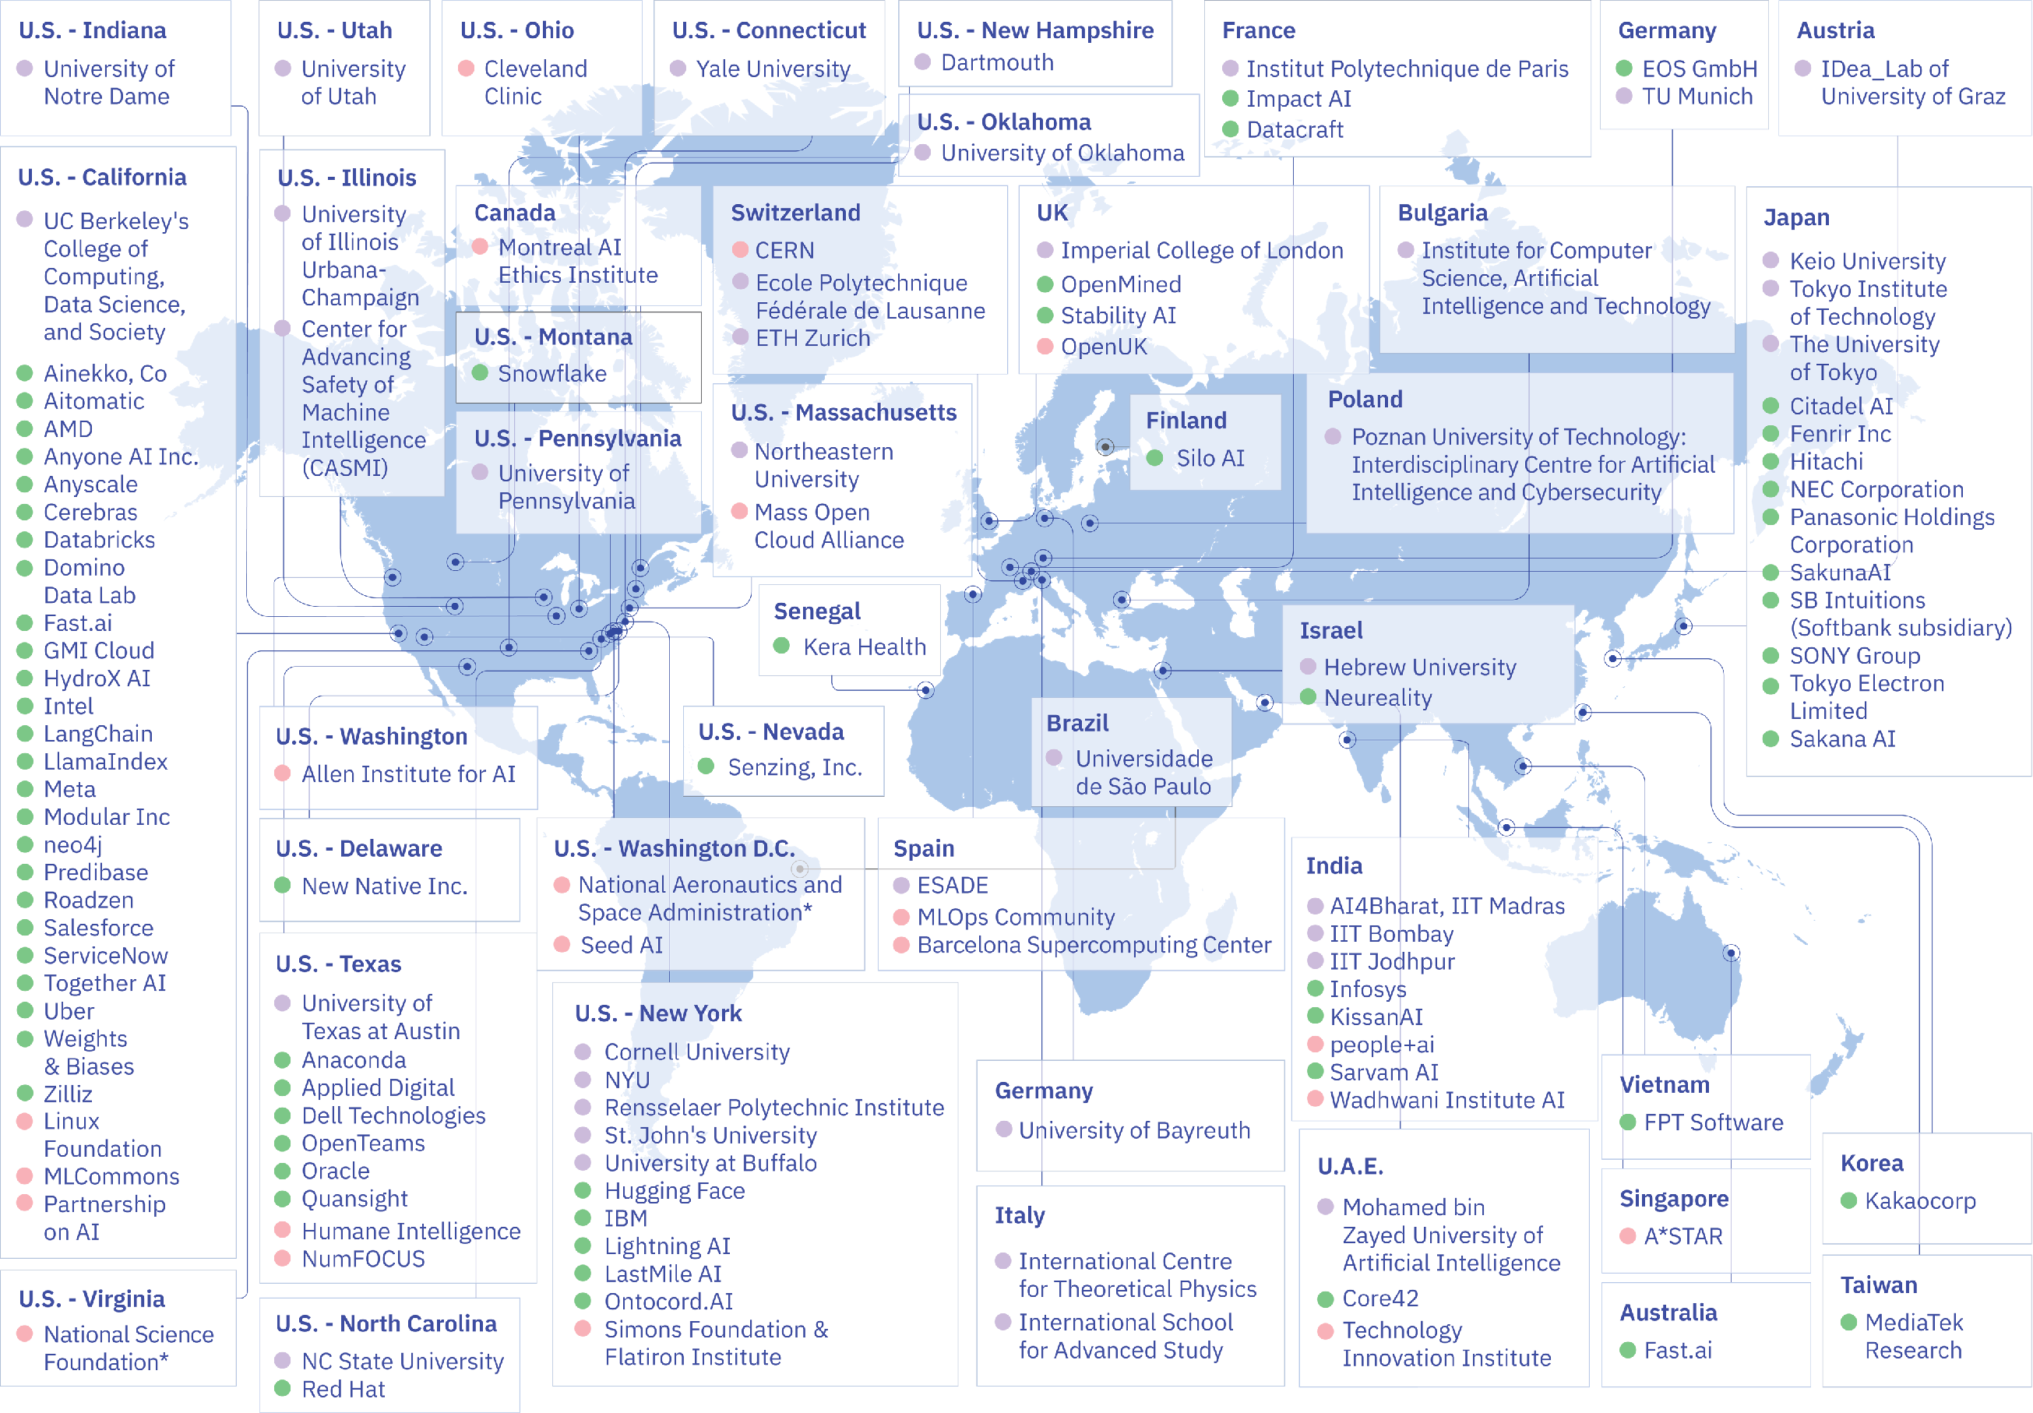
Map of Members
The AI Alliance is made up of ~200 organizations in 24+ countries, and growing
Member organizations in the AI Alliance comprise academia, commercial, research and non-profits and span the globe.
Our core beliefs in AI that is open is the tie that binds us, despite our differences.
Notes:
Map © 2023-2024, The AI Alliance

Slide 18
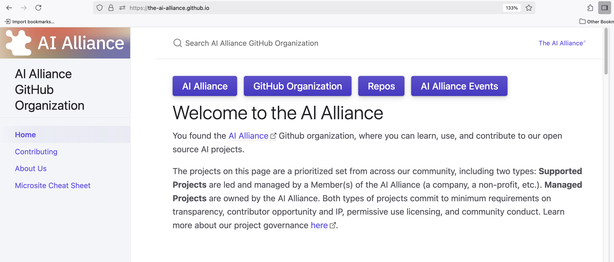
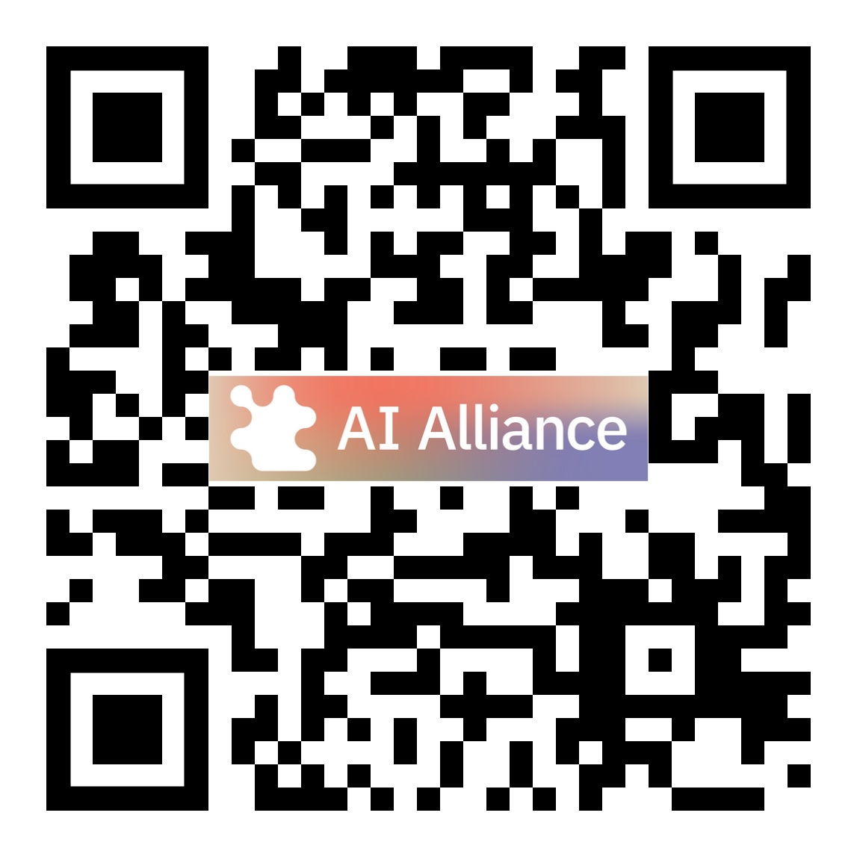
Numerous Projects:
github.com/the-ai-alliance.github.io

Slide 19
Outline
ContextForge
What Is the AI Alliance… and Why?
Building AI-empowered Applications: Agents, MCP, … and More
A Quick Look at Other AI Trends and AIA Projects
Final Thoughts

Slide 20
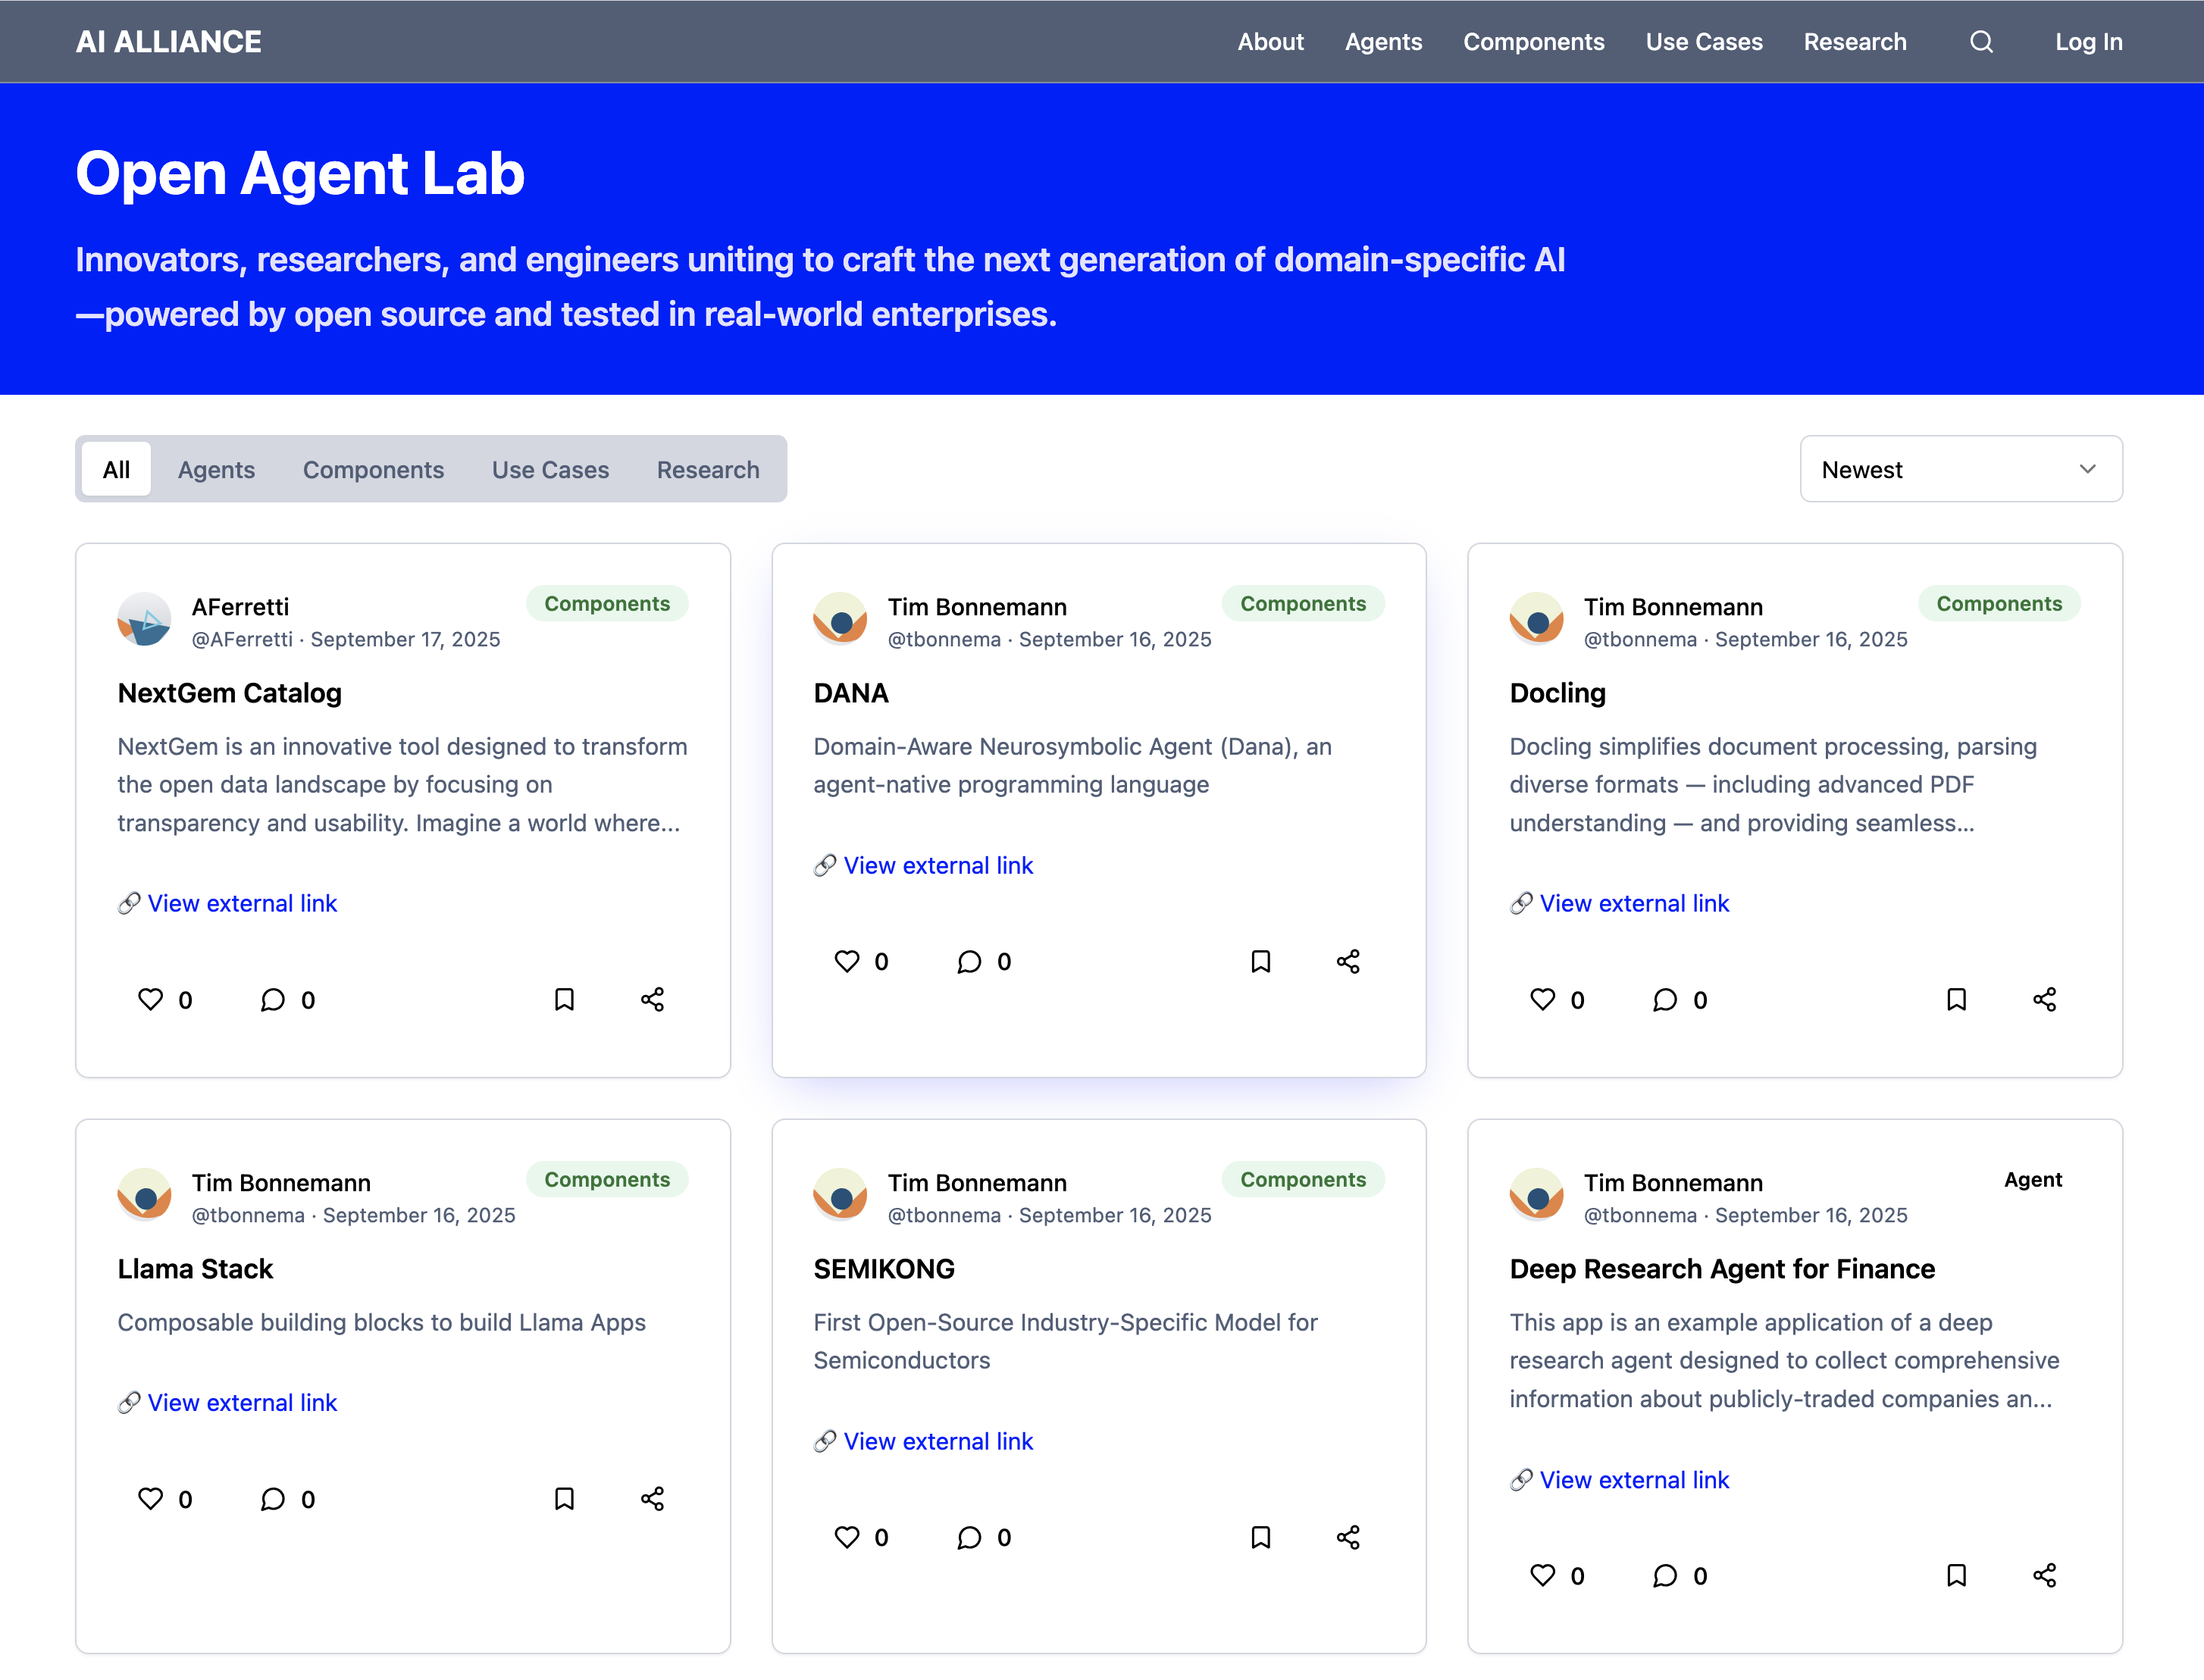
Open Agent Lab
github.com/the-ai-alliance.github.io

Slide 21
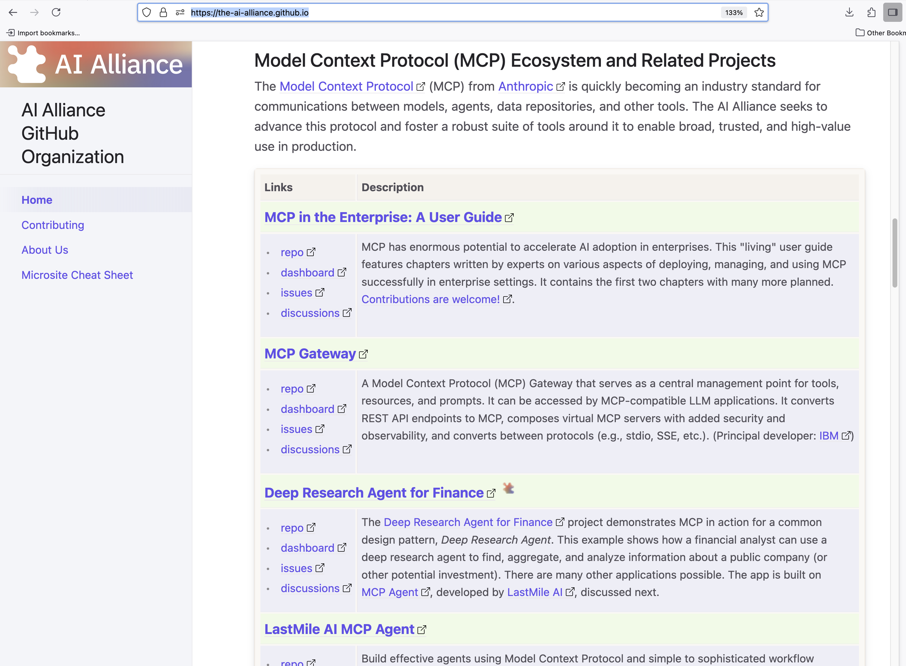
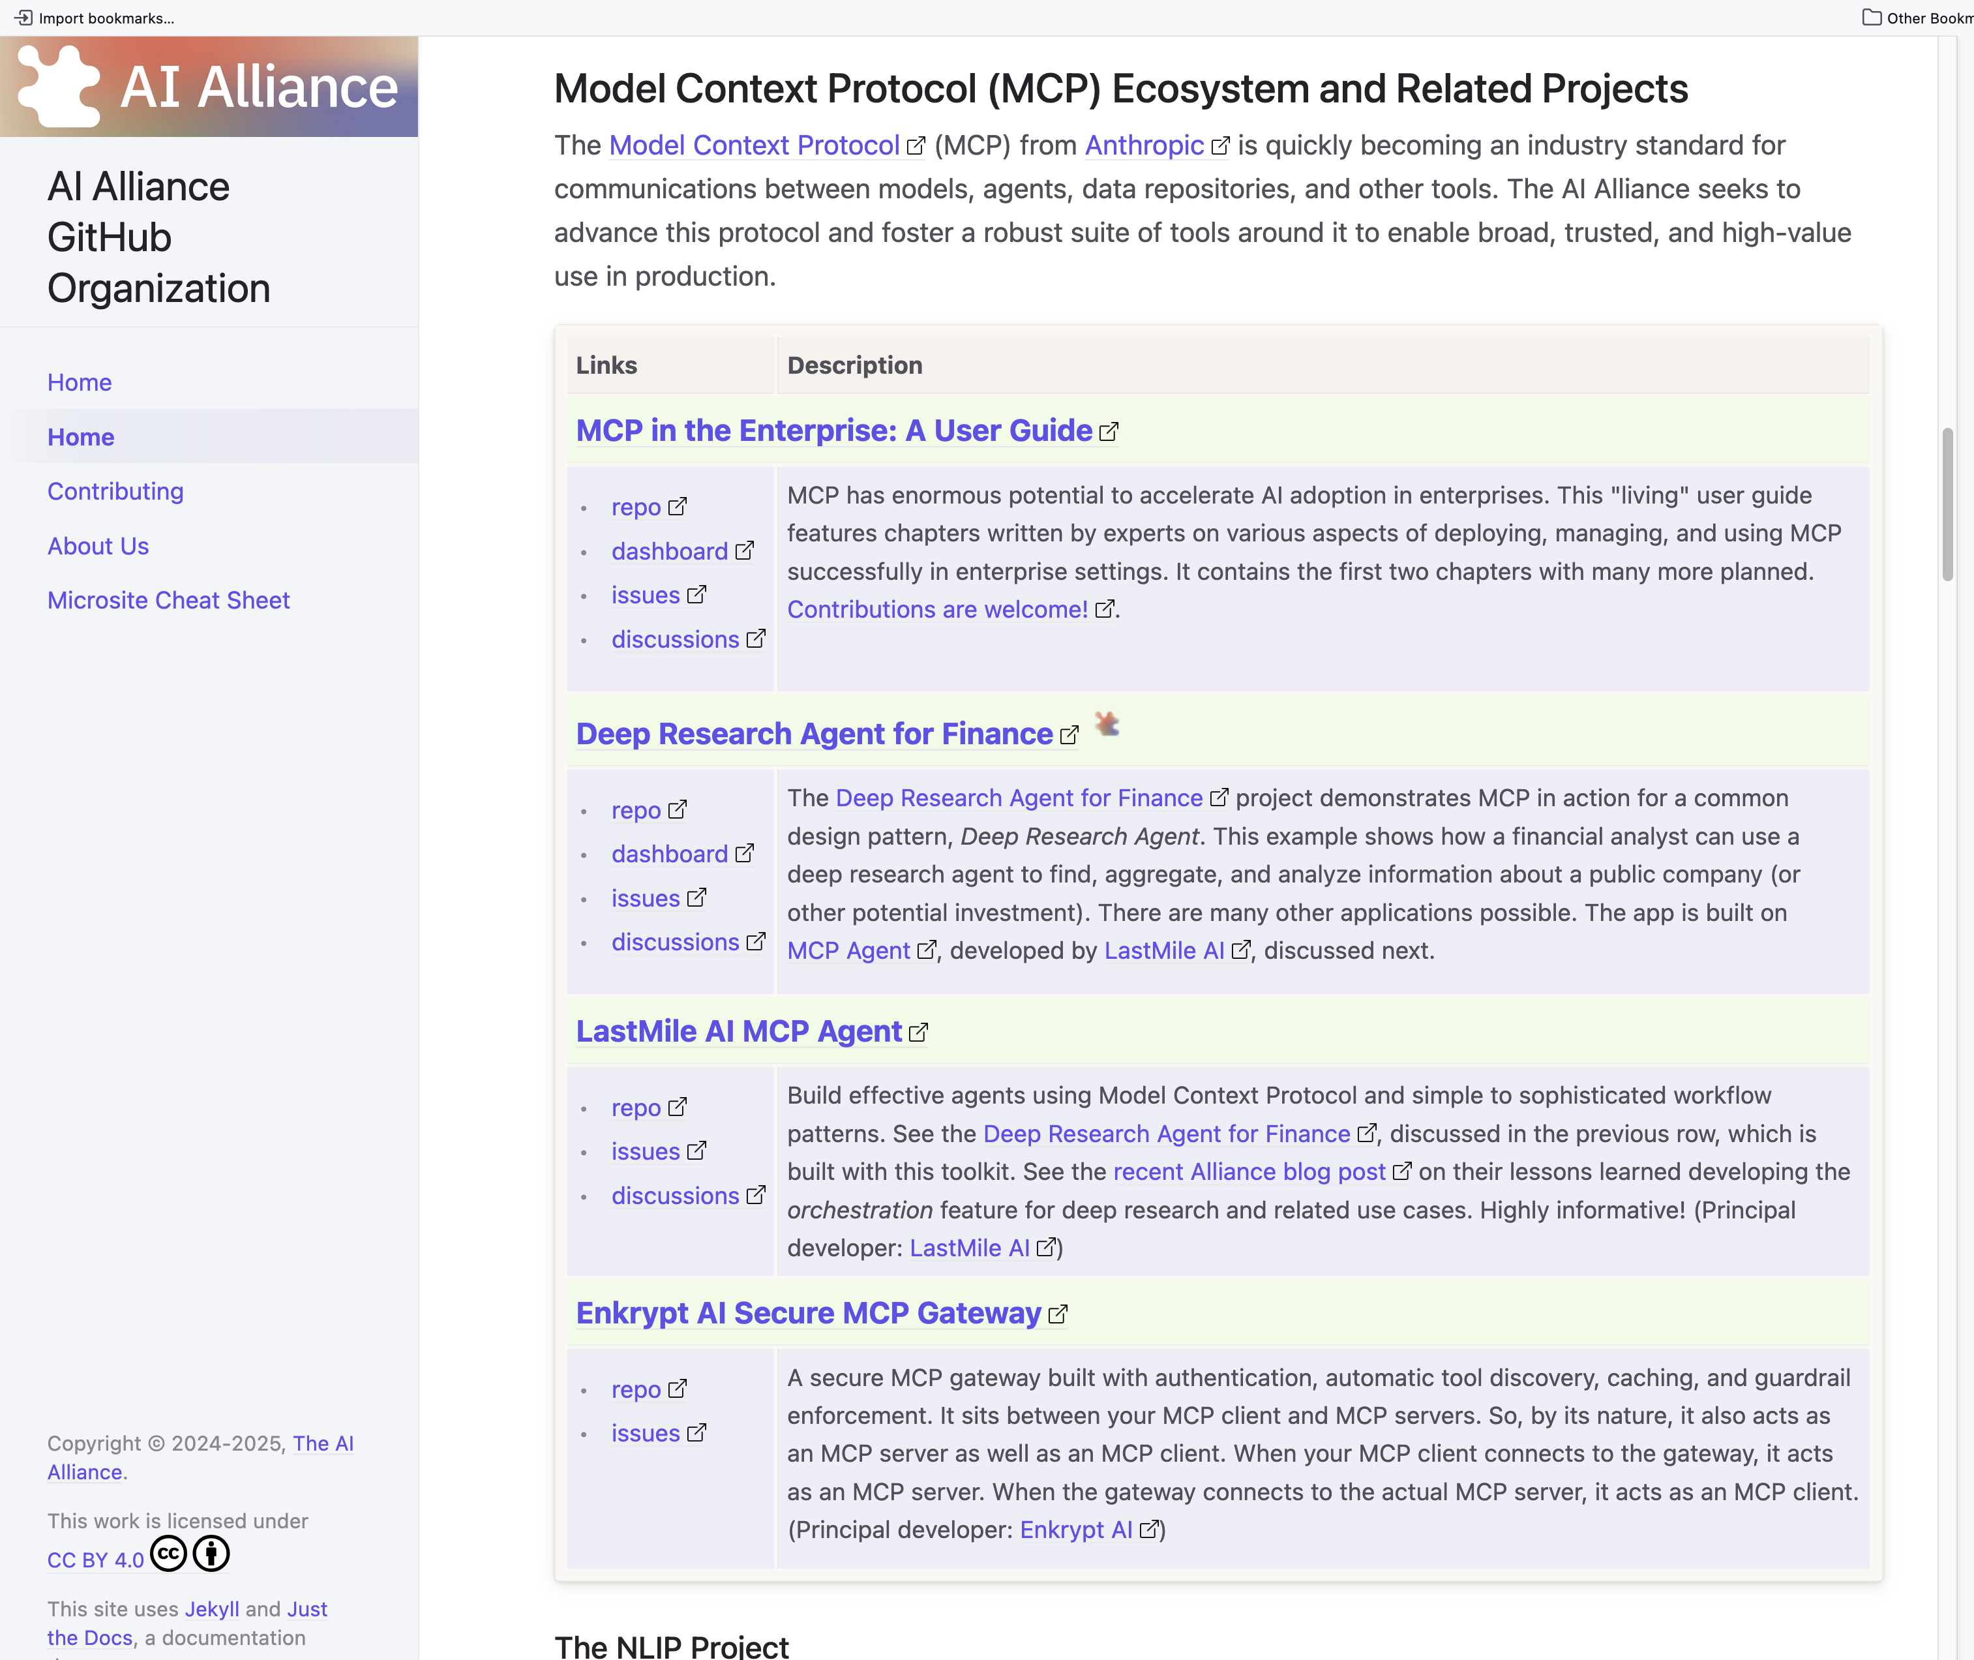
MCP Projects

Slide 22
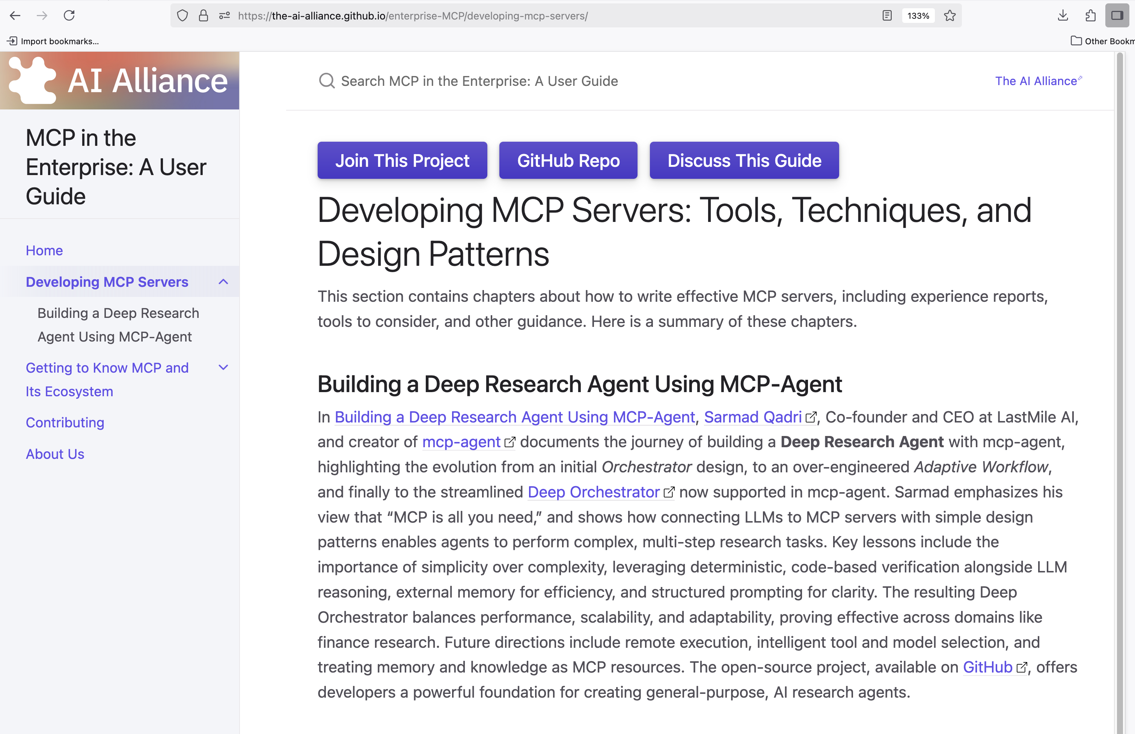
User Guide: MCP in the Enterprise
Demo

Slide 23
MCP + Agents

Slide 24
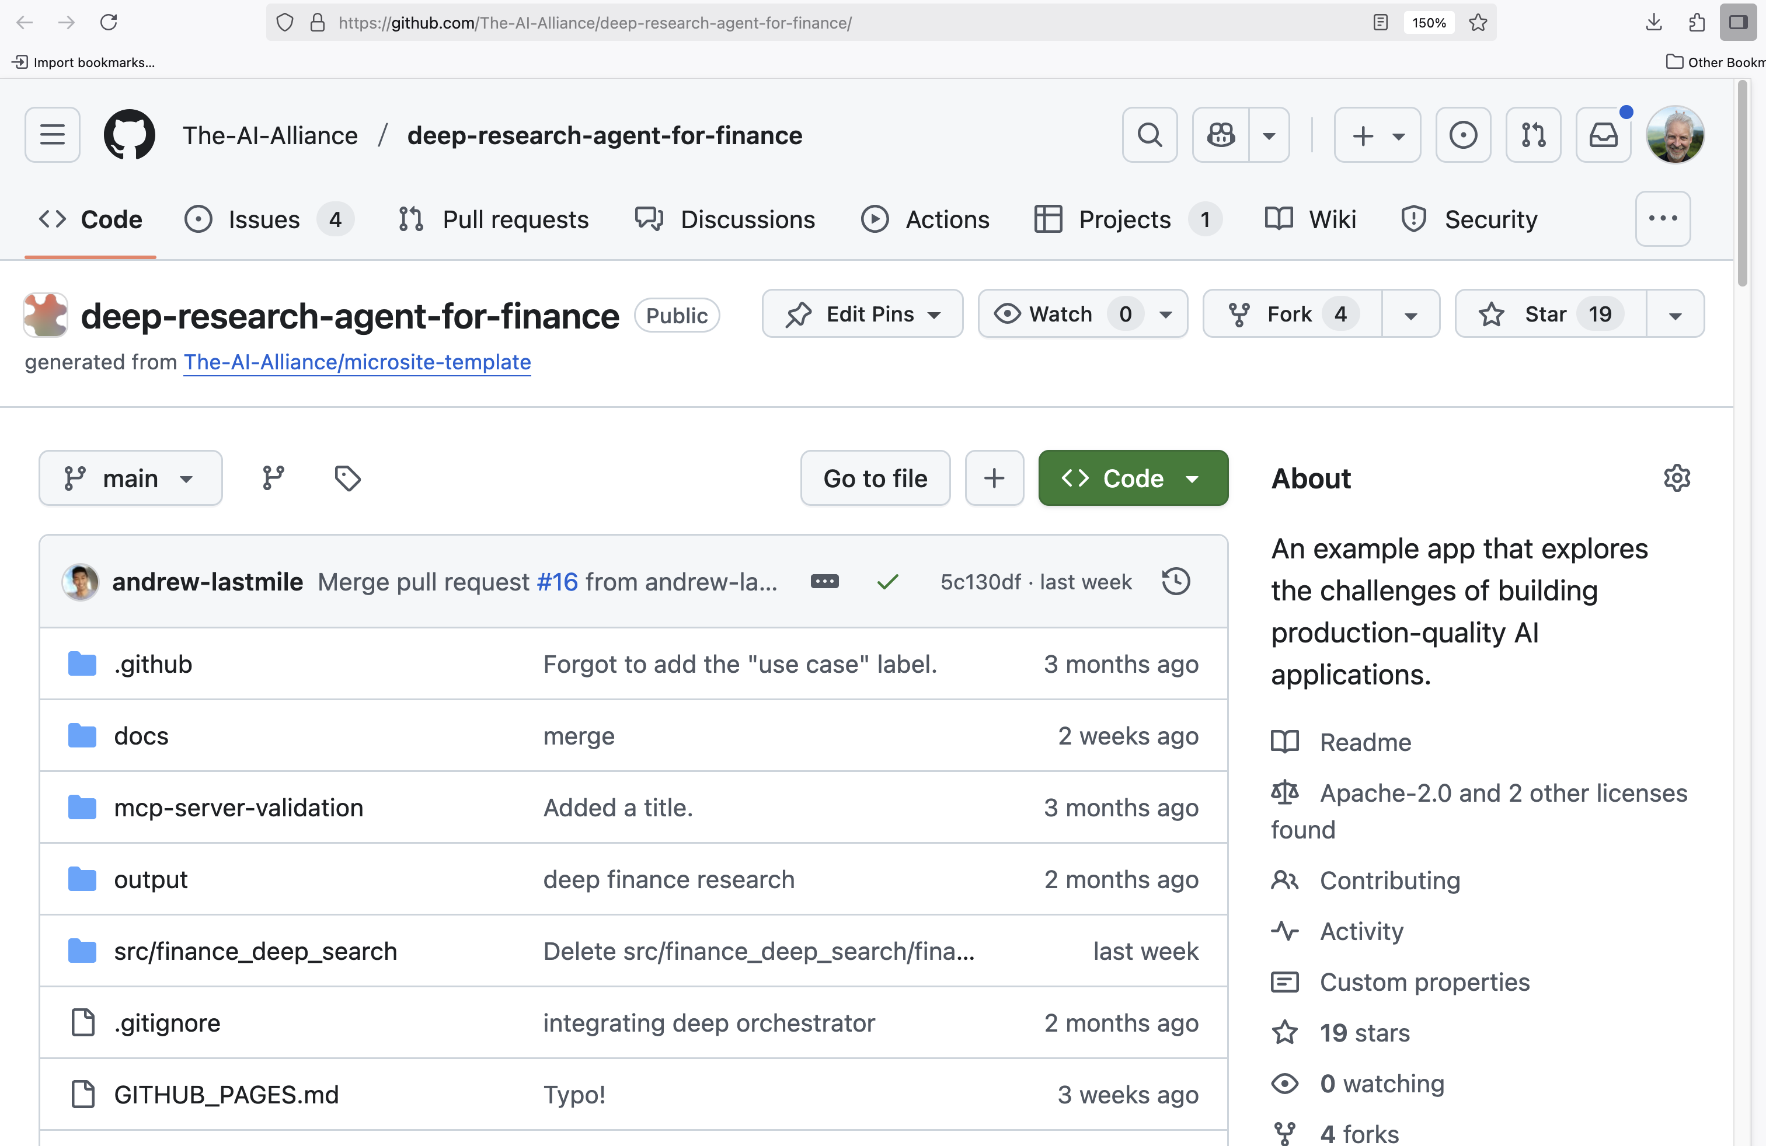
MCP + Agents: Deep Research App
Demo

Slide 25
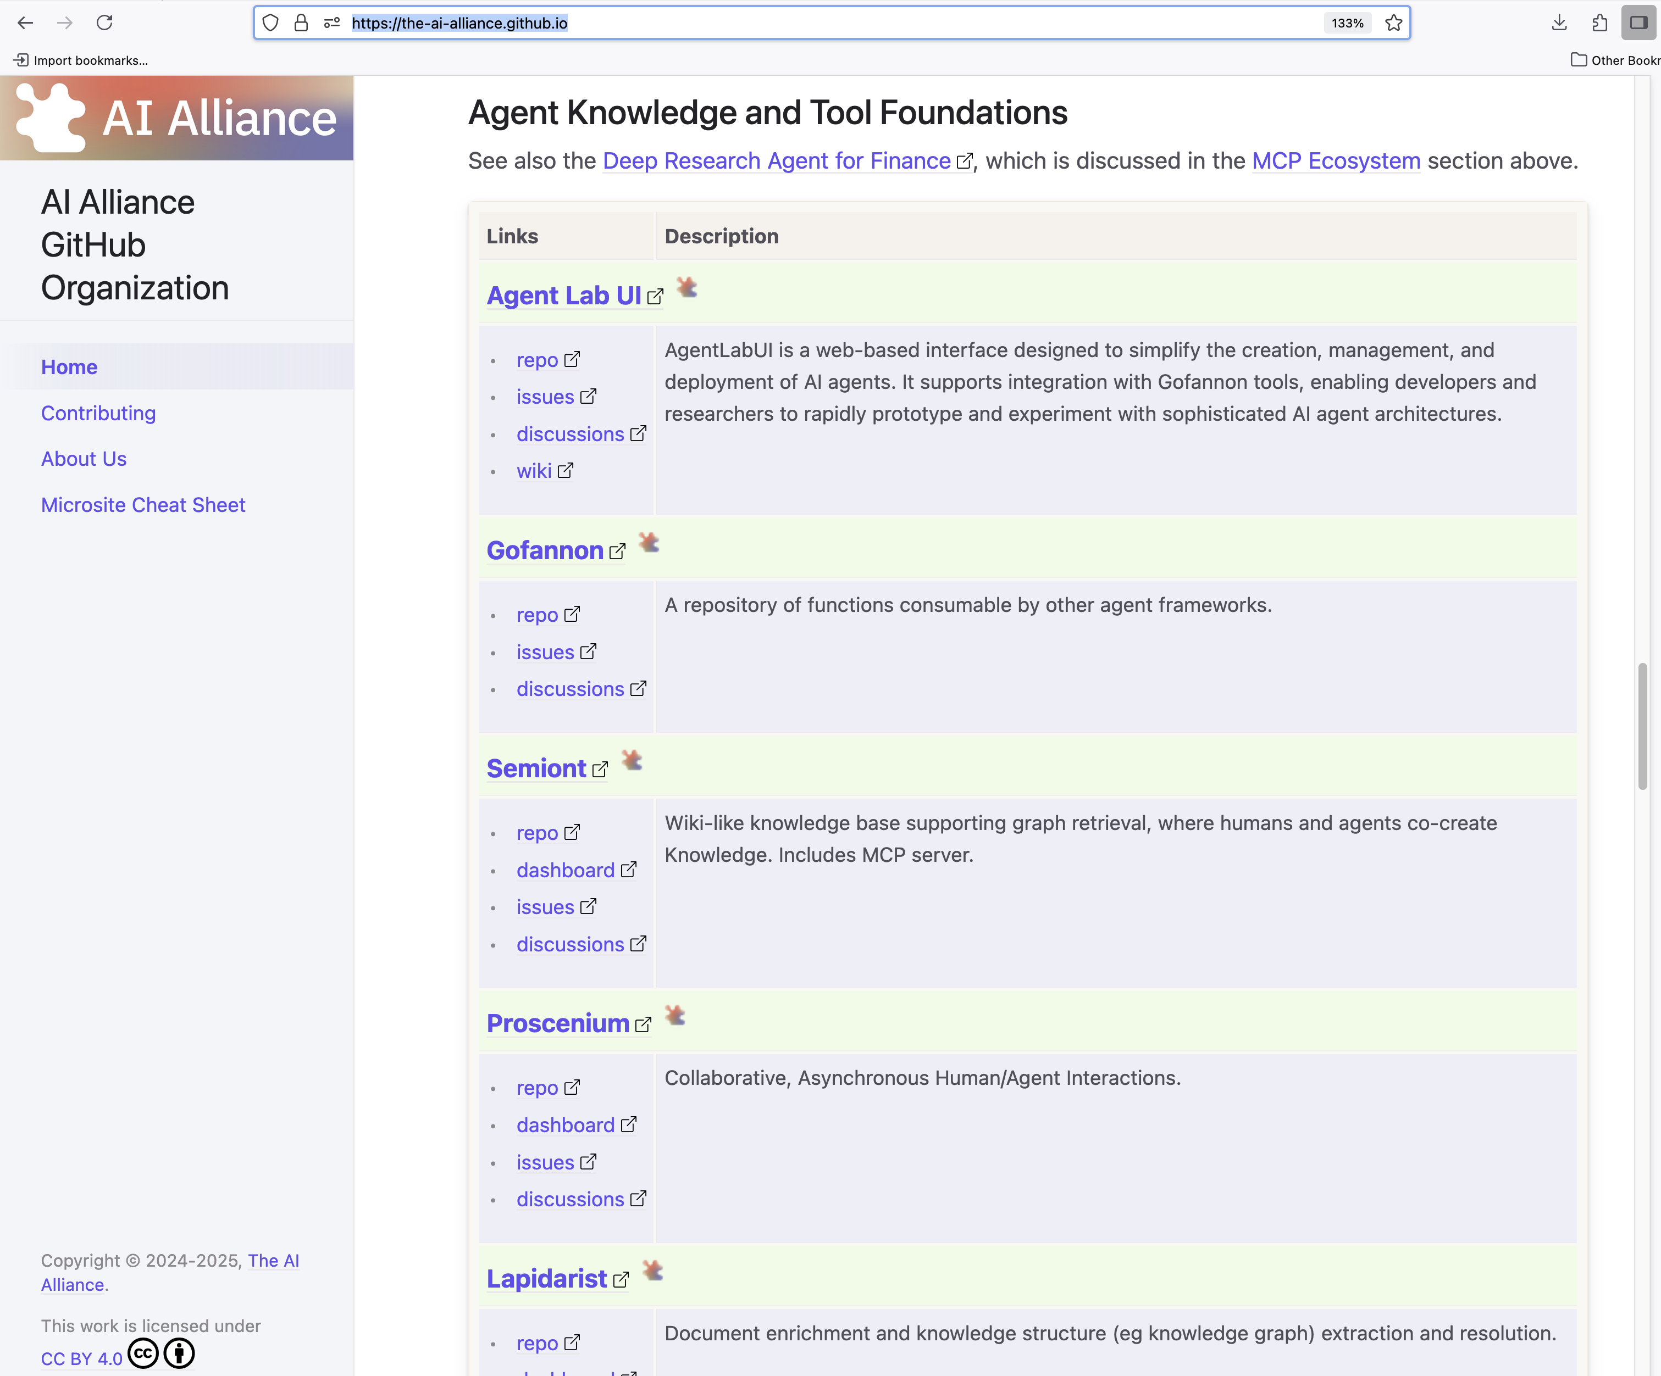
Numerous Projects: Knowledge, Tools

Slide 26
Outline
ContextForge
What Is the AI Alliance… and Why?
Building AI-empowered Applications: Agents, MCP, … and More
A Quick Look at Other AI Trends and AIA Projects
Final Thoughts

Slide 27

Problem: I want a full stack with consistent APIs

Slide 28
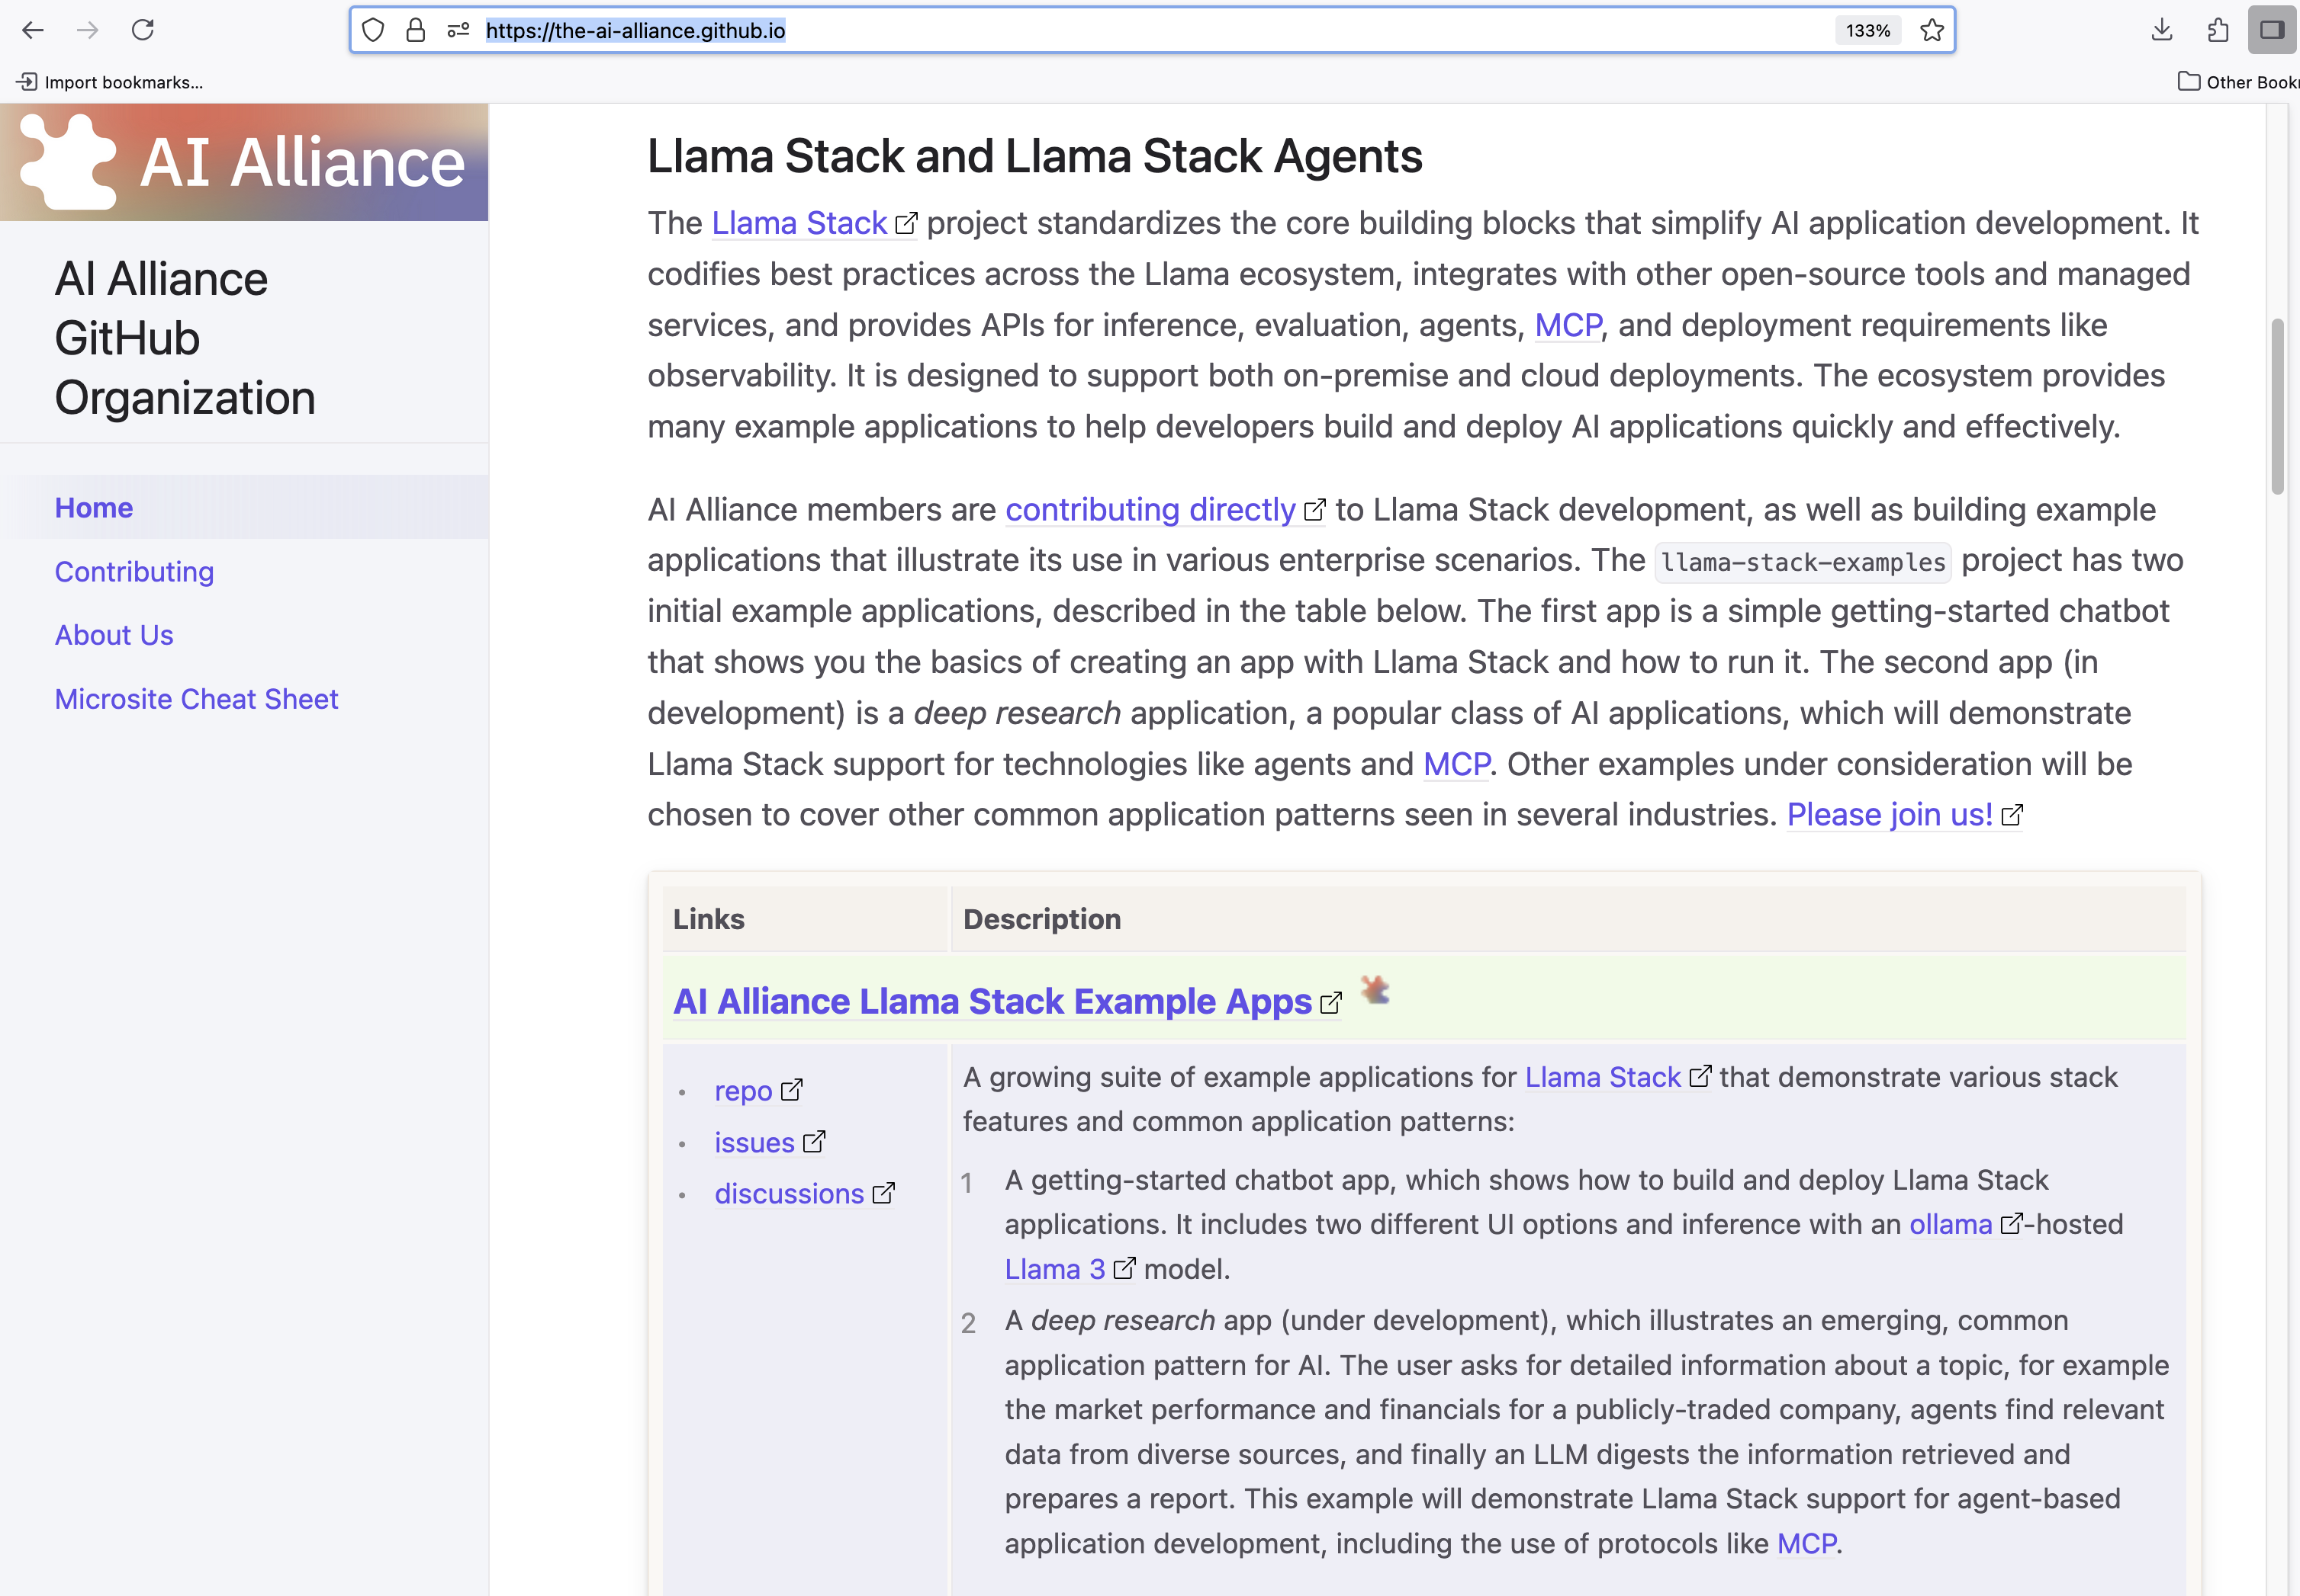
Solution: Llama Stack

Slide 29
Problem: I need open, trusted datasets

Slide 30
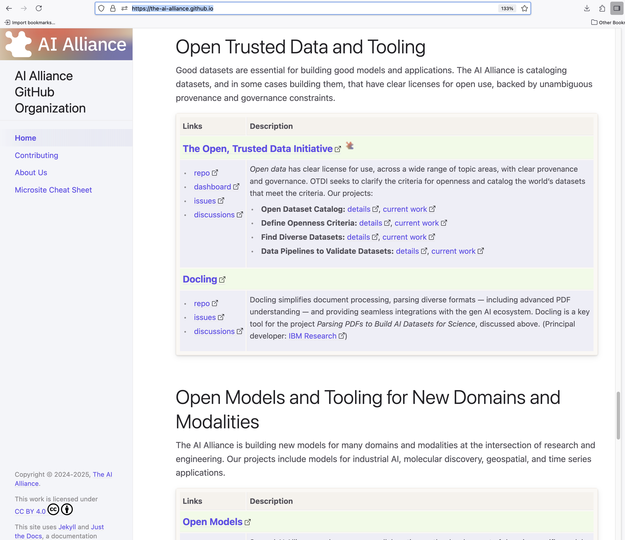
Solution: Open Trusted Data Initiative

Slide 31
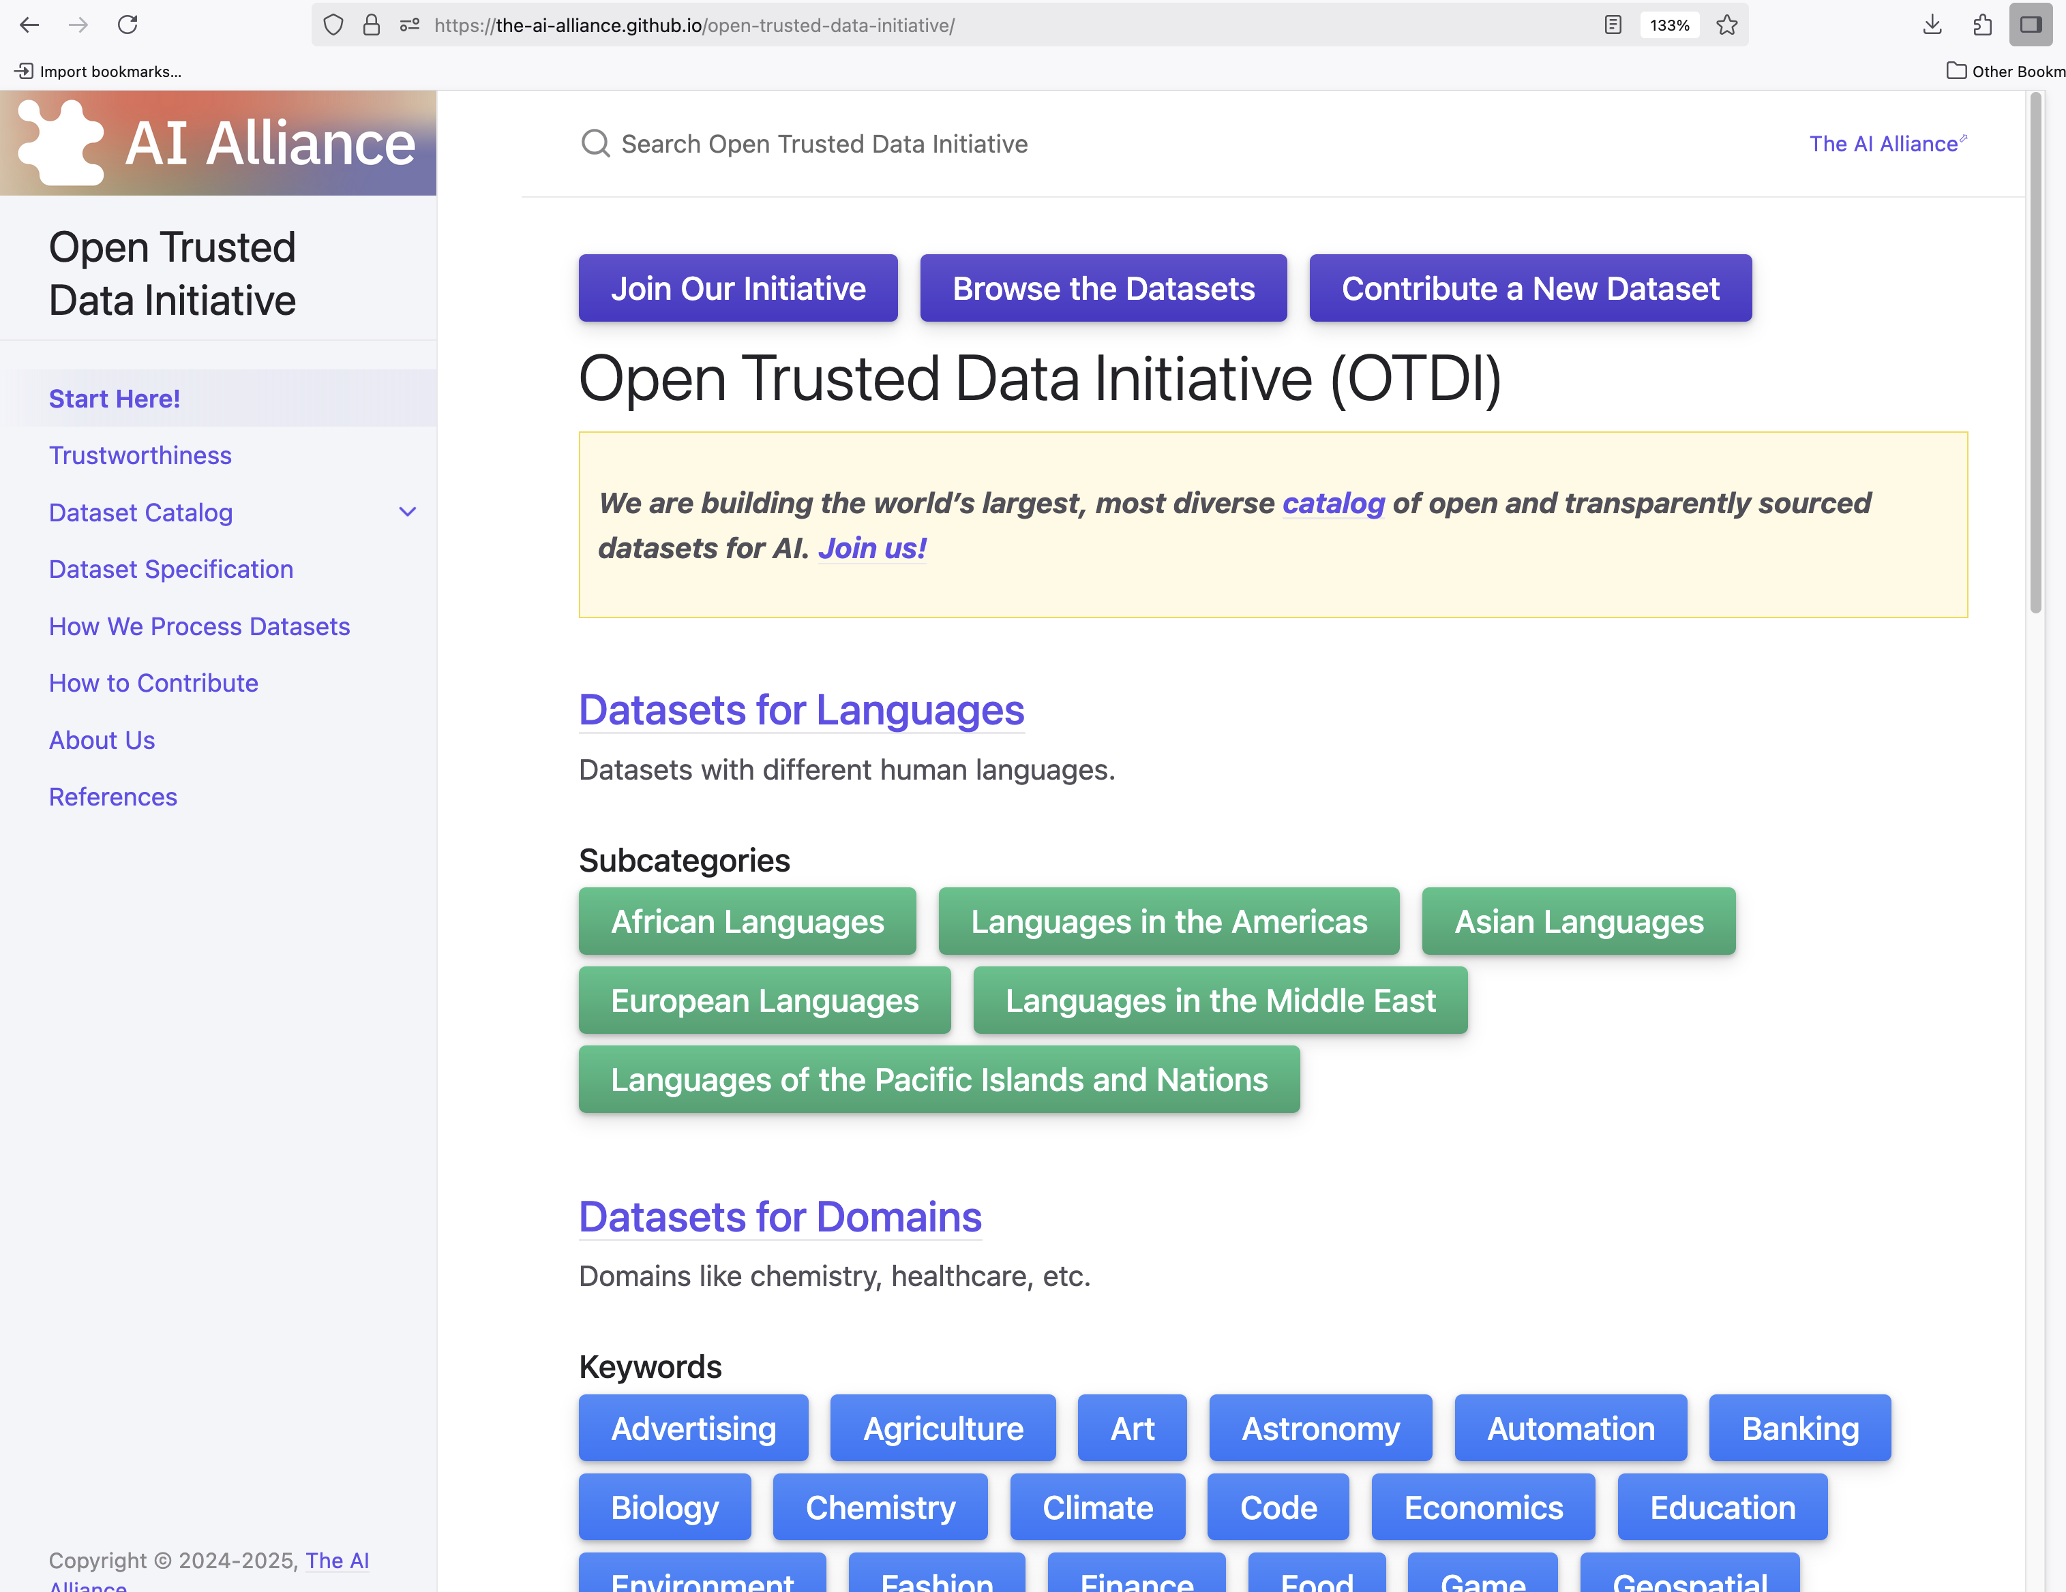
Solution: Open Trusted Data Initiative
Demo

Slide 32
Problem: I don’t know how to test AI-enabled apps!

Slide 33
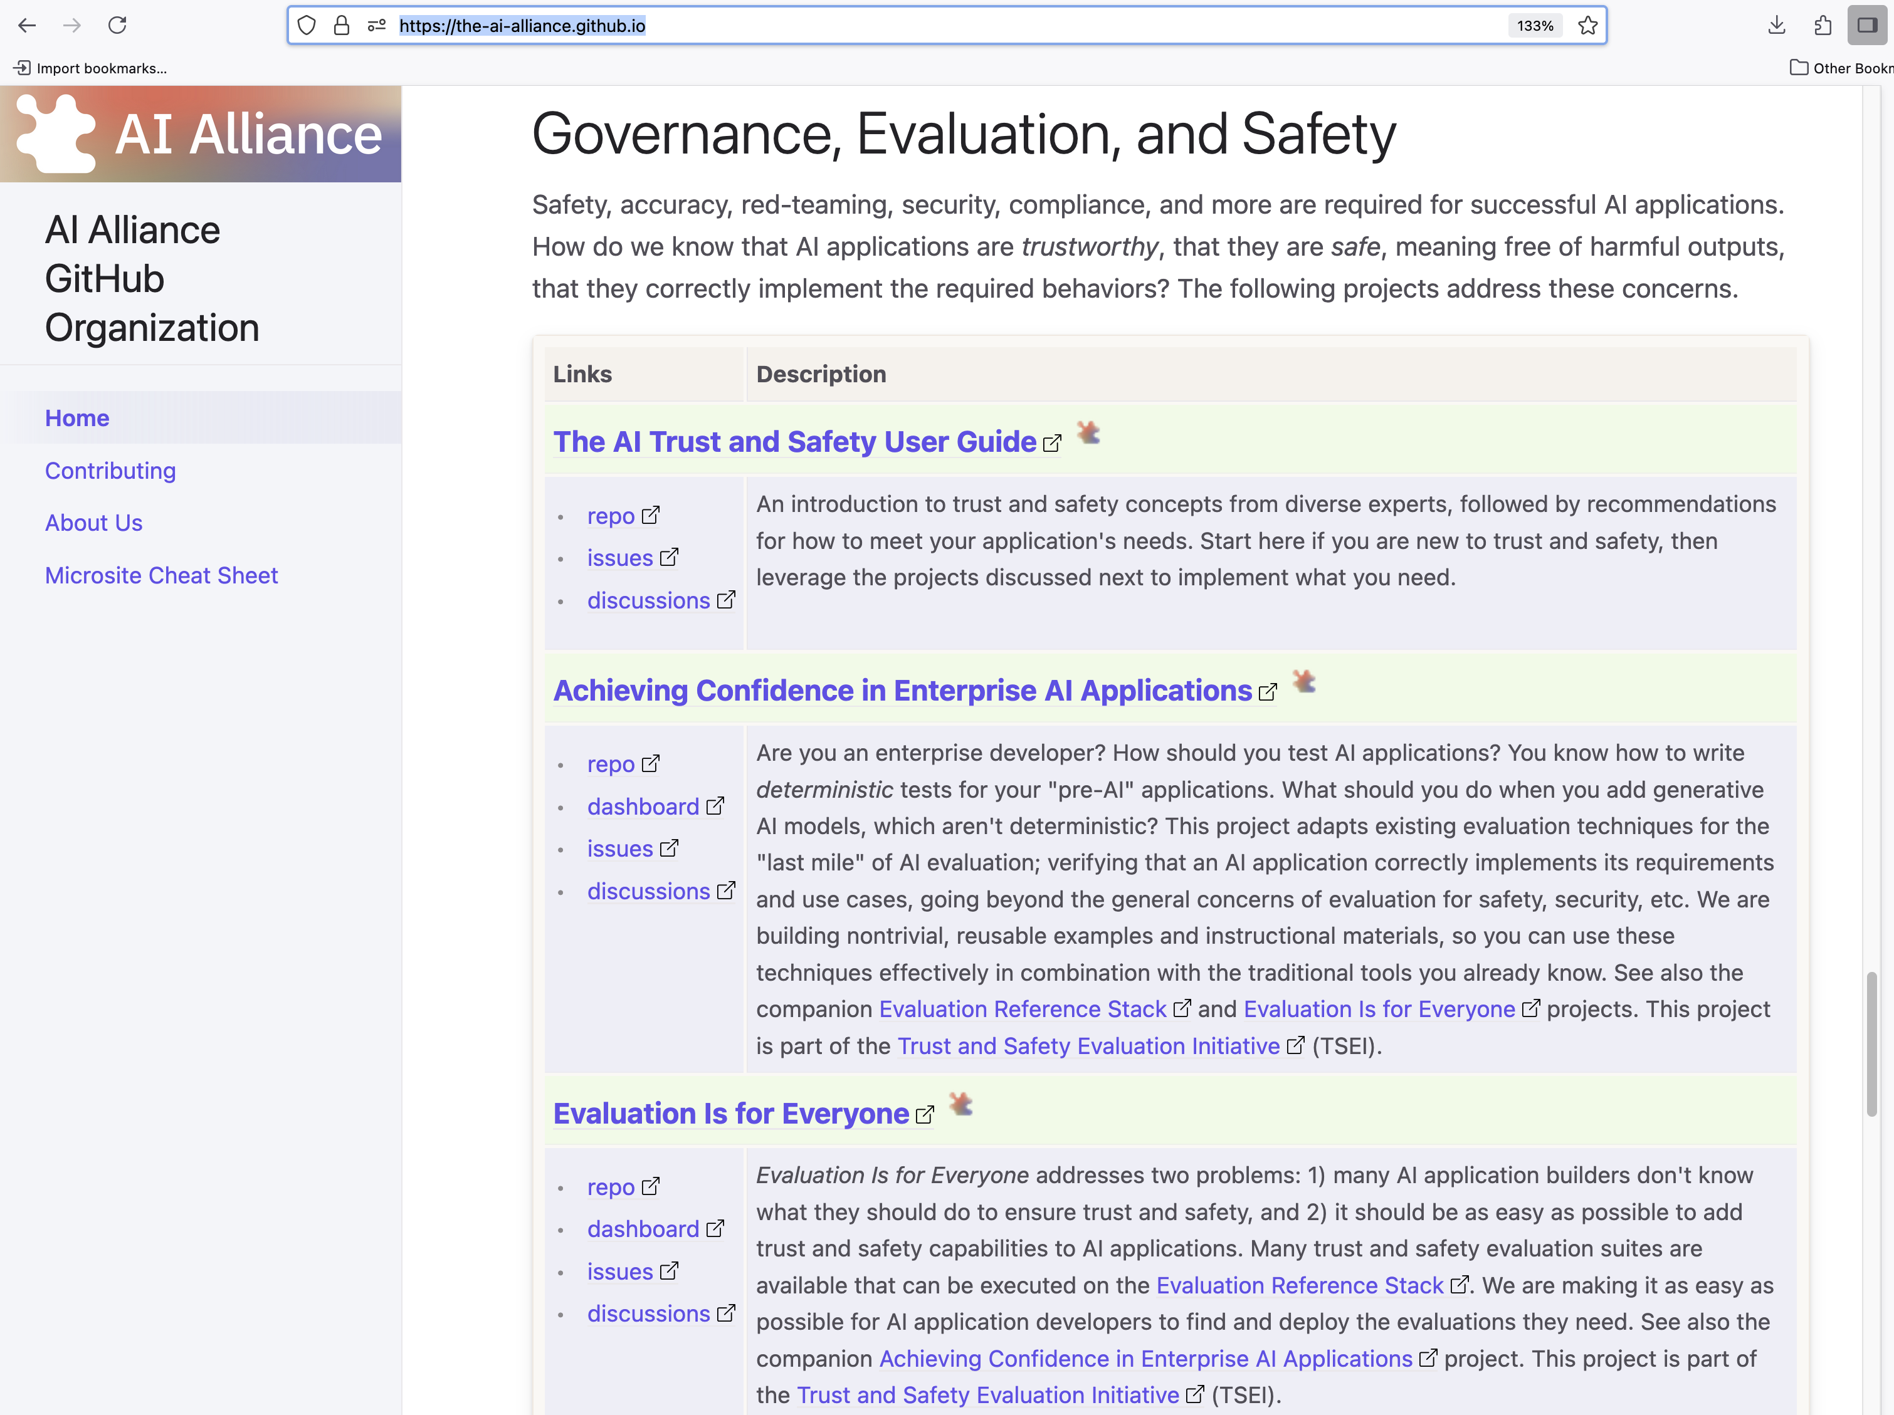
Solution: Evaluation and Safety

Slide 34
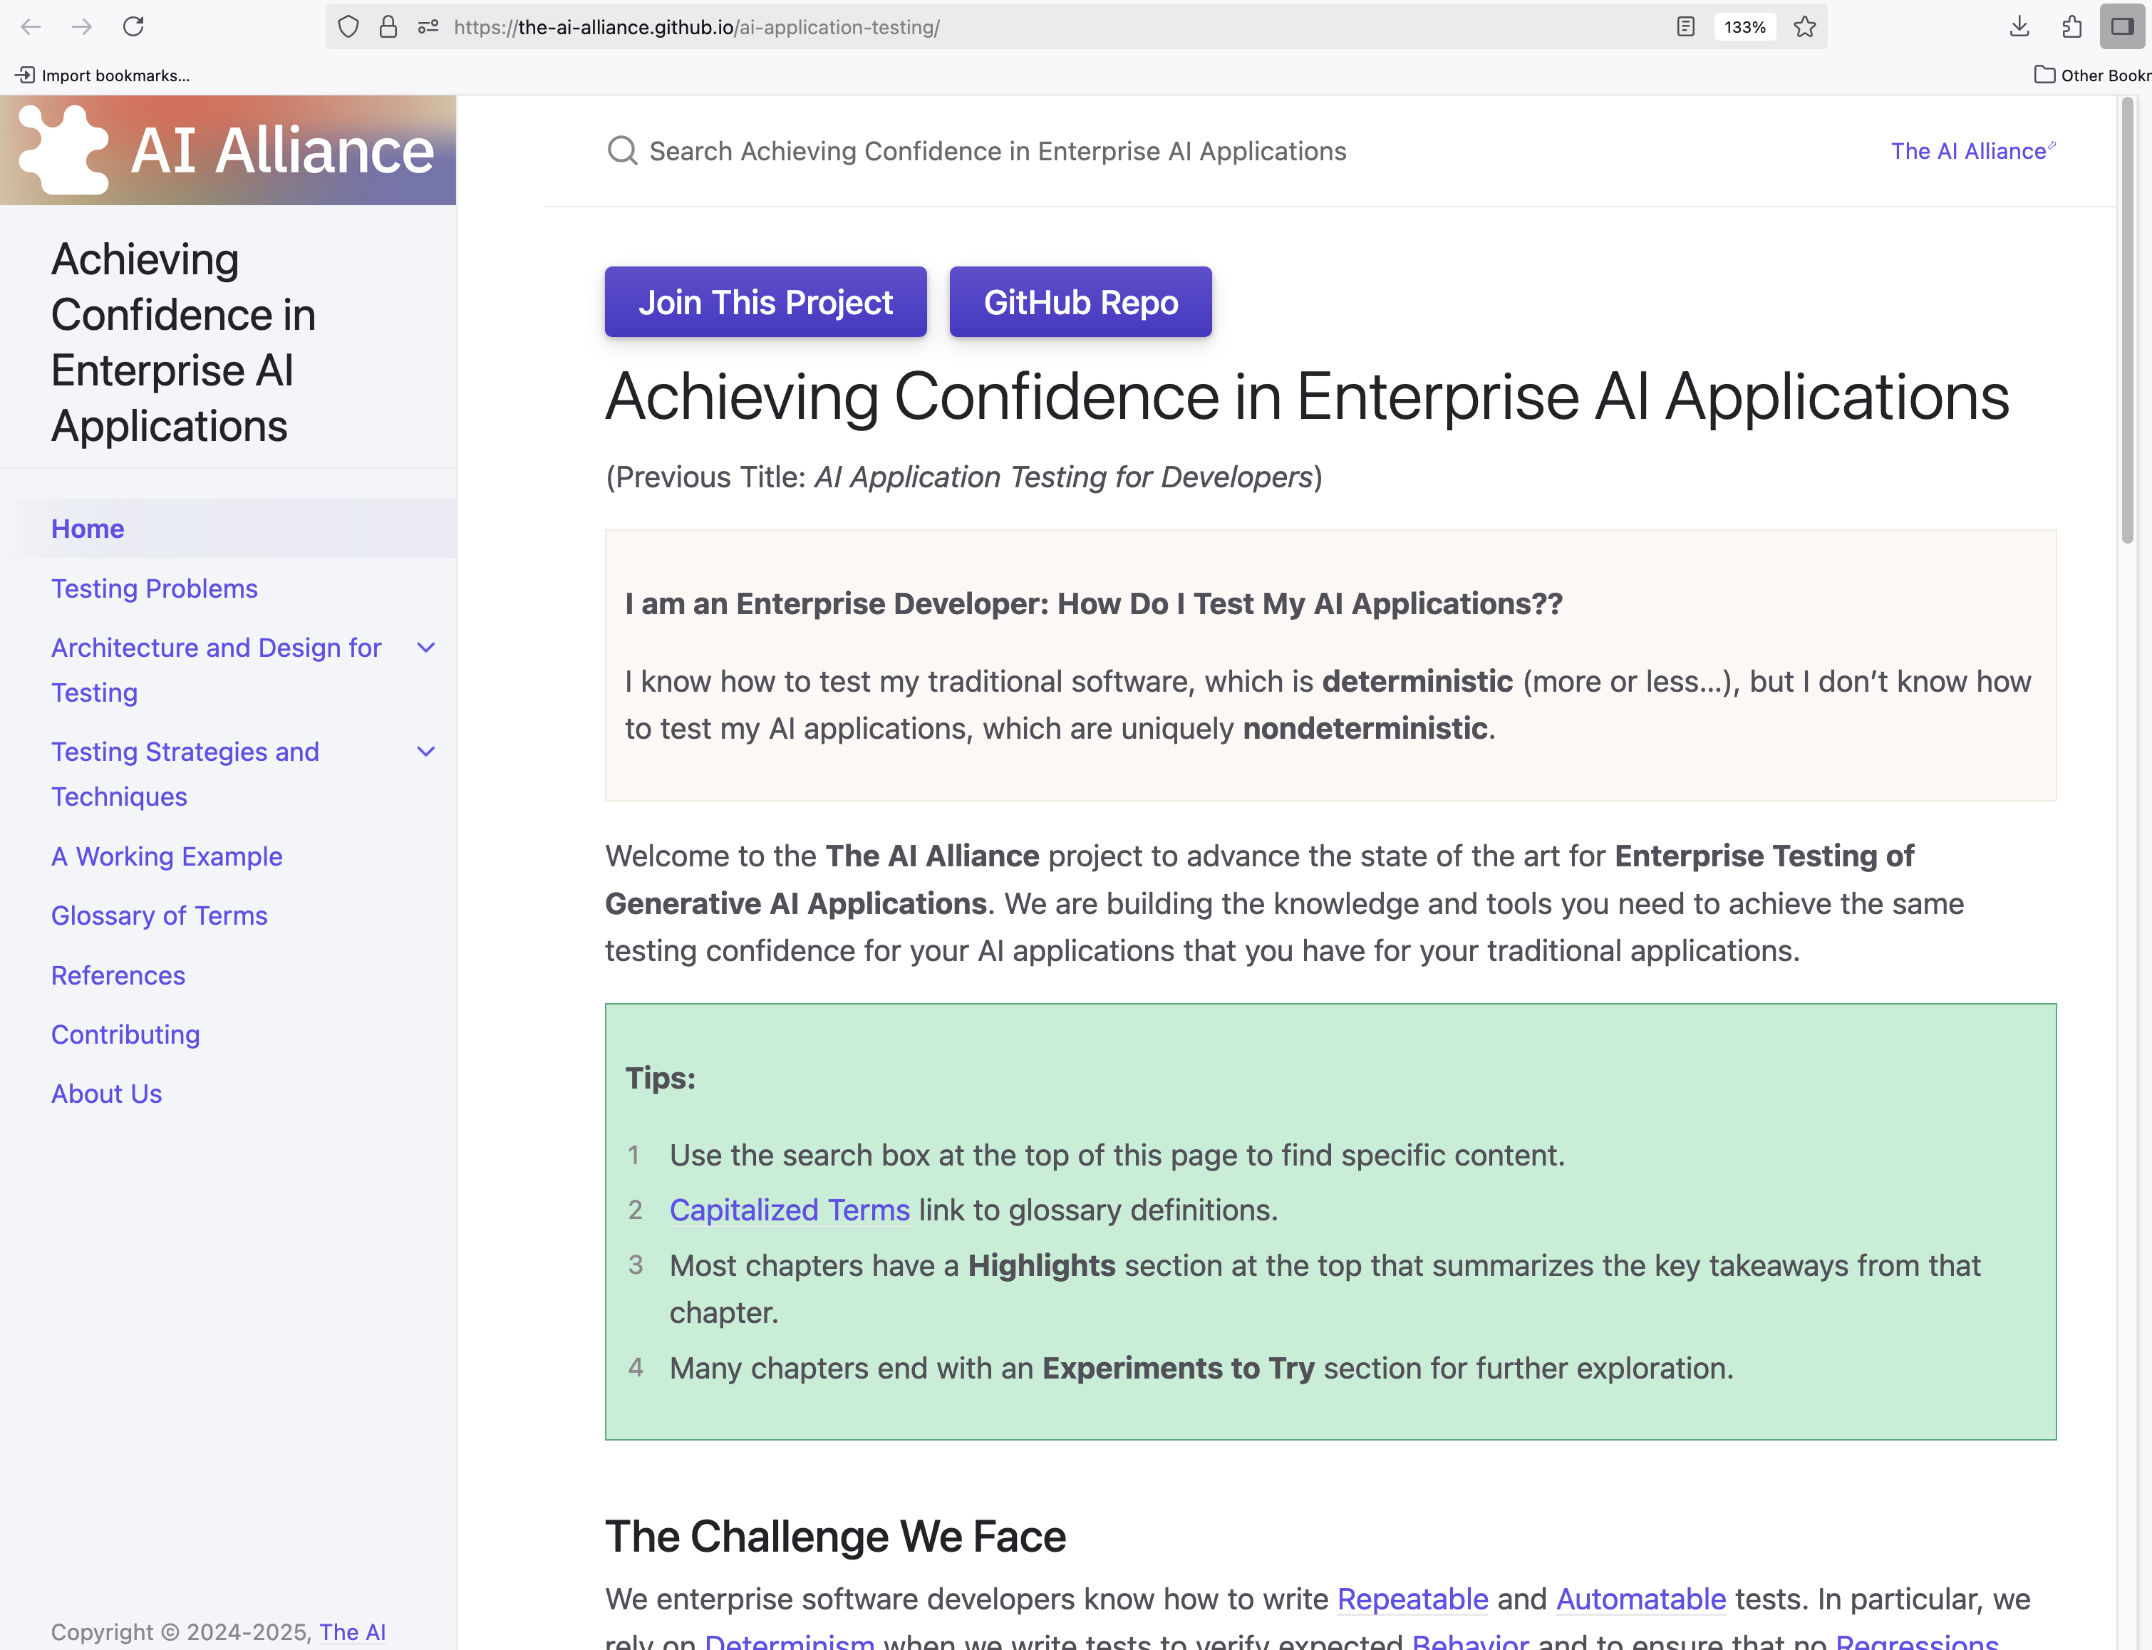
Solution: Evaluation and Safety
Demo

Slide 35
Outline
ContextForge
What Is the AI Alliance… and Why?
Building AI-empowered Applications: Agents, MCP, … and More
A Quick Look at Other AI Trends and AIA Projects
Final Thoughts

Slide 36

Final Thoughts

Slide 37

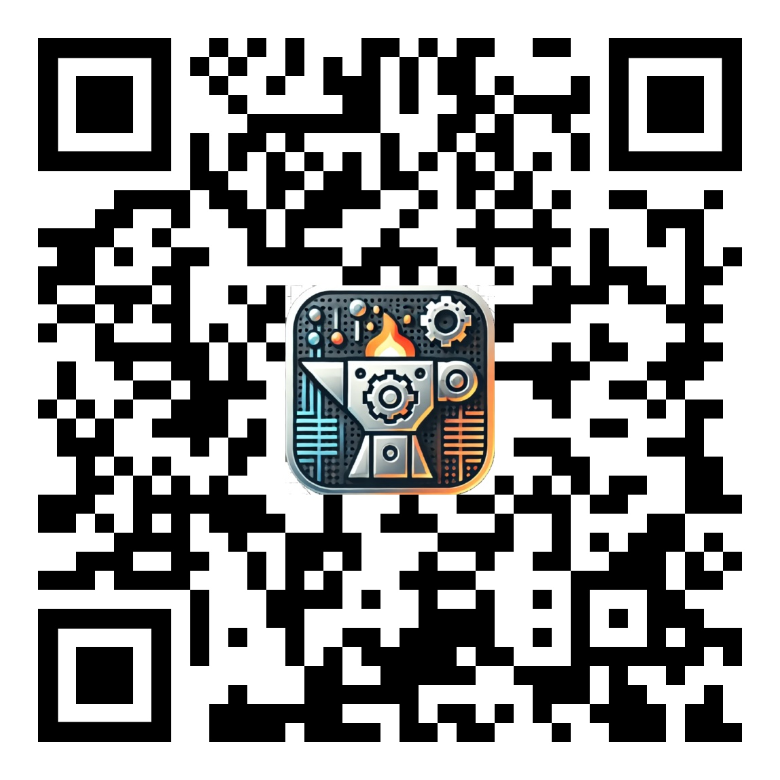
ContextForge - Meets many requirements for enterprise deployments of MCP.
The AI Alliance - Strives to make all users able to safely and successfully use AI.

Slide 38

ContextForge - Meets many requirements for enterprise deployments of MCP.
Fill out our Trust and Safety survey! What are you doing? What concerns do you have?
The AI Alliance - Strives to make all users able to safely and successfully use AI.

Slide 39

Extra Slides

Slide 40
Extra Slides
Retrieval-augmented
Generation (RAG)

Slide 41

Retrieval-Augmented Generation (RAG)
1
3
query
app
query + context
LLM
response
response
5
retrieve
“similar”
context data
4
2
context data
(vectors, graphs)
The first GenAI application pattern.
Improves alignment.
Incorporates new knowledge after training was done.
Incorporates proprietary domain or use-case knowledge.

Slide 42
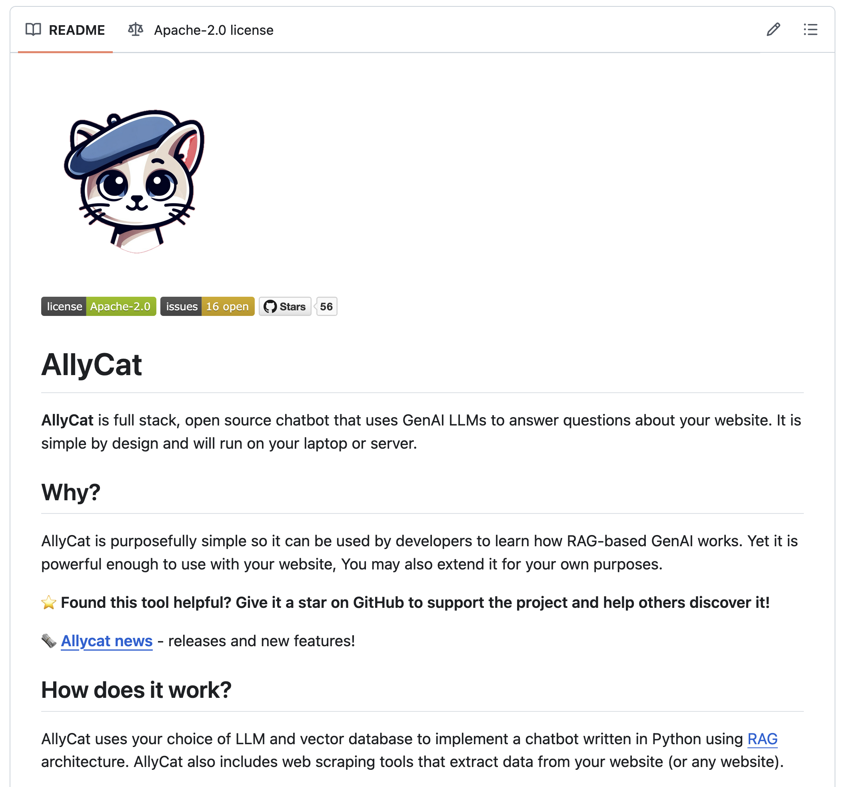
AllyCat
github.com/The-AI-Alliance/AllyCat/

Slide 43
Extra Slides
Agents and Model Context Protocol (MCP)

Slide 44
Agents and MCP
What do
I need?
Where is it?
agents
2
1
MCP
Gateway
3
query
queries
data
LLM
response
responses
search
6
5
4
analyze
Repeat 2-5 as needed!
The second+ GenAI application pattern(s).
LLMs do what they do best. Other tools do what they do best, orchestrated together.
Flexible for very diverse use cases.

